Slide 1
Welcome - We will start at 12:30 Area Prescribing Group Learning Lunch Wednesday, 6 December 2023 Sheffield Medicines and Prescribing
Notes:
DO we then remove this slide when we publish it on the intranet ?

Slide 2
Introductions
Sharron Kebell – Specialised Commissioning Pharmacist
Emily Parsons – Medicines Governance Pharmacist
Jill Rigby –Pharmacist Team Leader
Riz Iqbal – Clinical Pharmacist
House Keeping
Feedback welcome – see form in chat

Slide 3
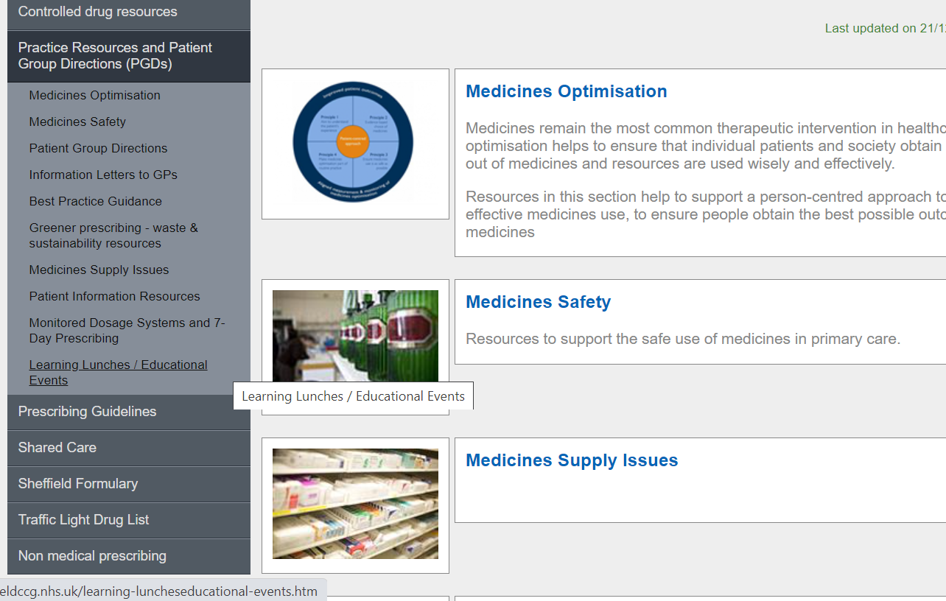
Missed the meeting/other learning lunch resources
Notes:
DO we delete this slide ? And place in separate place.

Slide 4
Learning objectives
To be aware of latest updates & suggested actions to:
Traffic Light Drug List
Share care protocols
Guidelines –
Medicines Safety update
General prescribing update; and
Education &Training opportunities

Slide 5
Traffic Light Drug List
A single SY ICB TLDL is in the process of being developed (SY IMOC). Please continue to refer to both Sheffield place and SY ICB TLDLs
To access both SY ICB TLDL and Sheffield place TLDL: Sheffield place intranet > Medicines and Prescribing > TLDL
Memantine orodispersible for moderate to severe Alzheimer's disease classified as GREY
- this is based on cost, and the oral solution is a more cost-effective option
All other IMOC approved TLDL changes are GREY or RED – Optimise Rx will be updated with these changes.
Avoid adding any RED medicines prescribed by hospital to patient’s repeat record. Add as ‘hospital only drug’ see here for details: Specialist Issued Drug.
Notes:
Focus currently is on aligning the GREY list medicines across the 4 places. Recent case(s) where RED medicines issued accidentally as placed
On repeat Rx

Slide 6
Efmody (Hydrocortisone MR ) Shared Care Protocol (SCP) across South Yorkshire ICB
The SCP has been published, and Efmody ® classified as AMBER on the TLDL for patients with congenital adrenal hyperplasia. It is considered as a third line option after immediate release oral hydrocortisone and prednisolone have been unsuccessful.
Monitoring to be done as per clinical indication by the specialist in secondary care. Annual monitoring will be undertaken to assess response to treatment, continued benefits realised from third line treatment, sick day rules and emergency injection training.
Continue to prescribe up to 16 months from last hospital review and then convert to conventional glucocorticoid treatment. Conventional glucocorticoid treatment dosing as agreed with secondary care.
Add a date for conversion to prescribing record to ensure this is actioned.

Slide 7
Primary care prescribing guidance: Dapagliflozin▼ & Empagliflozin ▼ in Heart Failure with Reduced Ejection Fraction (HFrEF) in patients with and without Diabetes Mellitus
Dapagliflozin and empagliflozin are Sodium-glucose cotransporter-2 inhibitors (SGLT2i)
Amber on the Sheffield Traffic light drug list for use in HFrEF
Prescribing
For diabetics and non-diabetics- HF Specialist will write FIRST prescription
For diabetics who are on insulin/sulphonylurea (SU), GP will be asked to write first prescription and liaise with diabetic specialist nurse (DSN) so that adjustments can be made to the insulin / SU as there is a risk of hypoglycaemia with dapagliflozin (GP to refer patient to DSN)
Empagliflozin & dapagliflozin is only indicated for HFrEF for patients already managed with angiotensin-converting enzyme (ACE) inhibitors or angiotensin‑2 receptor blockers (ARBs) or sacubitril valsartan, with beta blockers, and, if tolerated, mineralocorticoid receptor antagonists (MRAs) NICE TA 679
Monitoring
On-going blood monitoring at 3 months is already required for HFrEF patients on these treatments.

Slide 8
Renal Impairment Expect a drop in the U&Es initial decline stabilises after 3 months. Deterioration below the eGFR will usually require either a discussion with the heart failure specialists (cardiologist or nurses), or a referral to the renal physician who will advise accordingly. Patient counselling Additional hypoglycaemic effect of SGLT2i in diabetic patients. Counsel patient about the risks of hypotension, and the increased incidence of genito-urinary candidiasis and the rare occurrence of Fournier’s gangrene Highlight in clinical record the indication for dapagliflozin or empagliflozin as heart failure (HFrEF) to ensure it is not stopped in diabetic patients at routine diabetes review.

Slide 9
Guideline to support Primary Care with management of Chronic Kidney Disease (CKD) in Adults
Now published
Two categories of patients with CKD: with or without type 2 diabetes. Same risk factors to manage and different criteria and/or targets for prescribing
Introduction of the SGLT2 inhibitors (SGLT2i), Forxiga (dapagliflozin) to reduce the risk of CKD progression, see TA 775 . Jardiance (empagliflozin) SmPC has been updated in September 2023 to include CKD. TA to support this: in development. Guidelines will be updated once NICE TA published
NICE CKD Referral Criteria as per NICE NG203
Self-management advice for patients with CKD with numerous resourceful links for patients and clinicians
A stepwise approach to prescribing of dapagliflozin with criteria for prescribing, contraindications as per STH guideline Sodium Glucose Co-Transporter 2 Inhibitors (SGLT2i) Combined Cardio-Renal-Metabolic Prescribing Guideline for use in adult patients with and without diabetes
Monitoring and the importance of MDT collaborative work to support with glycaemic control
Sick day guidance and patient information letter Getting the most from your SGLT2 inhibitors
Further educational events to follow in the New Year
Clearly document indication for SGLT2i in patient’s records/medication
Be aware of the additional hypoglycaemic effect of SGLT2i in diabetic patients
Counsel patients on the risks associated with SGLT2i and symptoms to look out for: e.g. genital thrush/UTI, DKA, Fournier’s gangrene

Slide 10
Medicines Safety
Private / NHS interface e.g. transgender, ADHD etc:
RDTC Transfer of prescribing from private provider to NHS GP
National Safety alerts
Isotretinoin (Roaccutane▼)
The MHRA have strengthened the safe use of isotretinoin through the introduction of additional oversight of the initiation of isotretinoin in patients under 18 years and through improved assessment and monitoring of mental health and sexual function issues.
Ozempic▼(semaglutide) and Saxenda (liraglutide): vigilance required due to potentially harmful falsified products
Between January 2023 and October 2023 the MHRA has seized 369 potentially falsified Ozempic pens. They have also received reports of falsified Saxenda pens that have been obtained by members of the public in the UK through non-legitimate routes.
E-cigarette use or vaping: reminder to remain vigilant for suspected adverse reactions and safety concerns and report them to the Yellow Card scheme
Healthcare professionals should be vigilant for suspected adverse reactions and safety concerns associated with e-cigarettes and e-liquids, commonly known as vapes.
NPSA - Valproate

Slide 11
Updated Pink Card & Process
A ‘Community Administered Medication Record Pink Card’ is required for adult patients in Sheffield
prescribed pre-emptive medications with or without a subcutaneous infusion via a syringe pump,
to authorise community nursing staff to administer these medications for the patient.
From 29th November 2023:
A new version of the Pink Card has been rolled out and must be used (identified by issue date of June 2023).
If the old version of the Pink Card is already being used for a patient in the community, this does not need to be rewritten.
New process for Sheffield Teaching Hospitals and St Luke’s Hospice who will now complete and issue Pink Cards for inpatients who are discharged to their own home or a care home.
The responsibility for issuing Pink Cards for all other patients remains with trained community transcribers/prescribers. The process for accessing and issuing Pink Cards in the community is unchanged:
All Community Nursing Teams have supplies of the new Pink Card.
GP practices should request blank Pink Cards via their link Community Nursing Team; they are also available via the Community Services Admin Hub at Firth Park/Lightwood House. Blank old versions of the Pink Card should be disposed of in confidential waste.
Pink Card Guidance & Resources: available on the CCG Intranet under Prescribing Guidelines > Palliative Care.
Contacts:
For clinical queries about a patient’s Pink Card: contact the clinical team managing the patient’s care.
To provide feedback on the Pink Card process: contact sth.pinkcard@nhs.net.
Authors: STHFT Pink Card Team

Slide 12
Other Medicines related issues
Unlicensed Medicines
If you are asked to prescribe medicines for an unlicensed / off label use, and as part of your decision-making process as to whether primary care should take on prescribing (in addition to the Medicines code),
you may wish to consult:
https://www.sheffieldteachinghospitalsformulary.nhs.uk/chaptersSub.asp?FormularySectionID=20
Please note however that above list is not exhaustive, there are many other examples of off-label and unlicensed medicines used by STH which are not listed here
Any medicine listed in this chapter will have been approved by STH’s Medicines Safety Group or Medicines Information depending on expected patient numbers
SPS has recently published some useful guidance on ‘Specials’ and ‘Unlicensed Medicines’. Click here to access these resources.

Slide 13
Education and Training
Innovation webinar
'Silver' award winner Antidepressant deprescribing clinic - NHS South Yorkshire on Monday, 11 December at
13:00 - 14:00.
Clinical Masterclass
Eczema management in primary care.
Tuesday, 19 December 2023 at 13:00 - 14:00.
All registered subscribers can sign up here.

Slide 14
Education and Training
Primary Care Discussions: Lipid Management
Tuesday, 12 December 2023 at 13:00 - 14:00· Online via WebEx
Registration is now open
Reviewing medicines for people at risk of falls
Tuesday, 9 January 2024 at 13:00 - 14:00· Online via WebEx
Registration is now open.

Slide 15
Summary Key actions
Summary of key Actions
Add
Reminder/Check
SGLT2i initiated from secondary care - unless patient is diabetic and on insulin or sulfonylurea.
Highlight in clinical record the indication for dapagliflozin or empagliflozin as (HFrEF)
Add
Note and highlight to colleagues
New Pink card process
Check out
Check out learning opportunities (all of which are free to attend)
Add a date to Efmody prescribing record for conversion to conventional glucocorticoid therapy after 16 months from hospital review
RED drugs as Specialist Issued Drug.

Slide 16
Next APG Learning Lunch
Date in February 2024 - to be confirmed
Feedback welcome:
https://forms.office.com/Pages/ResponsePage.aspx?id=slTDN7CF9UeyIge0jXdO443oflYckS5GlHWzOtEesnlUMDNDTkRVTDI1VTRaV1dPQlhMRFAyTkxNNy4u

Slide 17
Questions?

