Slide 1
Welcome - We will start at 12:30 Sheffield Place Area Prescribing Group – Learning Lunch Thursday, 1st February 2024 Sheffield Medicines and Prescribing
Notes:
DO we then remove this slide when we publish it on the intranet ?

Slide 2
Introductions
Sharron Kebell – Specialised Commissioning Pharmacist
Emily Parsons – Medicines Governance Pharmacist
Augustinas Slucka – Clinical Practice Pharmacist
Diana Vasile – Clinical Practice Pharmacist
Kirsty Burdett – Clinical Practice Pharmacist
Barbara Obasi – Clinical Effectiveness Pharmacist
House Keeping
Feedback welcome – see form in chat

Slide 3
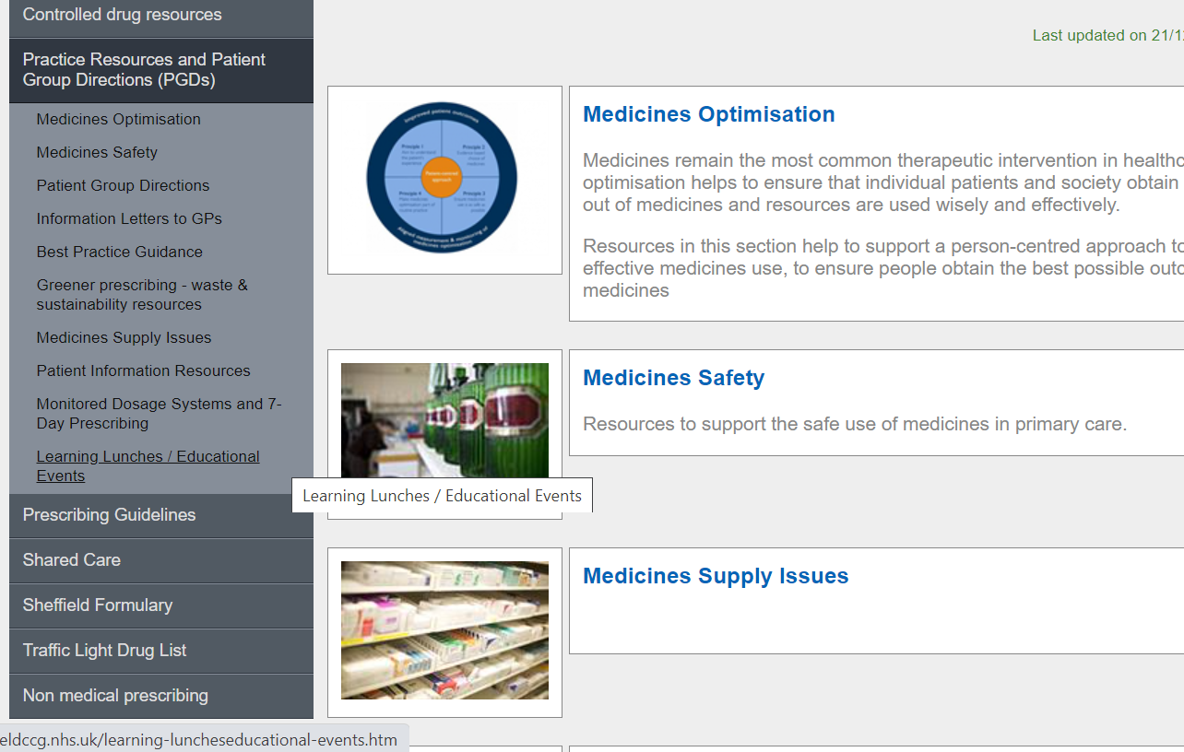
Missed the meeting/other learning lunch resources
Notes:
DO we delete this slide ? And place in separate place.

Slide 4
Learning objectives
To be aware of latest updates & suggested actions to:
Traffic Light Drug List
Share care protocols
Guidelines
Medicines Safety update
Education &Training opportunities

Slide 5
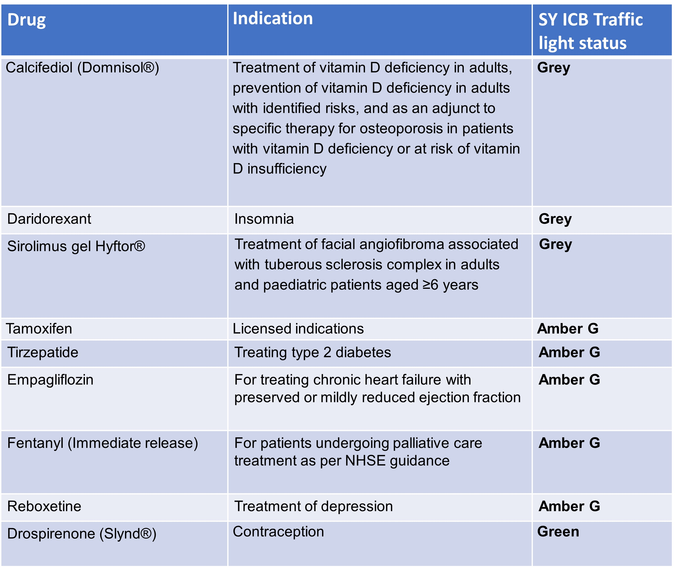
Traffic Light Drug List
A single SY ICB TLDL is in the process of being developed (SY IMOC). Please continue to refer to both Sheffield place and SY ICB TLDLs
To access both SY ICB TLDL and Sheffield place TLDL: Sheffield place intranet > Medicines and Prescribing > TLDL
Optimise Rx will be updated with all IMOC approved TLDL changes.
Avoid adding any RED medicines prescribed by hospital to patient’s repeat record. Add as ‘hospital only drug’
Notes:
Focus currently is on aligning the GREY list medicines across the 4 places. Recent case(s) where RED medicines issued accidentally as placed
On repeat Rx

Slide 6
Sheffield prescribing guidance in the self-monitoring of blood glucose (SMBG) for adults, children and young people
Document streamlined in length & relevance of information to make it more user friendly whilst retaining pertinent information for clinicians/HCPs using it.
SMBG recommendations updated in line with NICE guidelines NG17, NG28, NG18 , NG3 and DVLA guidance and in consultation with specialist services STH, SCH and Jessop
SMBG information expanded for children & young people (NG18) and in pregnancy (NG3)
Guidance designed into sections to support clinicians with advice on When to consider prescribing, what to offer At initiation and what to consider when reviewing.
Provides clinicians with supporting patient information leaflets to pass on to their patients
The second part of the guidance contains tables with specific guidance as to the quantity of testing strips appropriate to issue & frequency they need to be re-ordered to reduce unnecessary prescribing & potential waste
For advice on Continuous Glucose Monitoring (which measures interstitial glucose levels) see South Yorkshire Guidance for Continuous Glucose Monitoring (CGM) in Adults and Children with Type 1 and Type 2 Diabetes
Familiarise yourself with the updates and always refer to diabetes specialist services if/when additional support is required.

Slide 7
Shared Care Protocol – The Treatment of Children with Recombinant Growth Hormone
Somatrogon (Ngenla®▼) has been added to SCP with separate designated sections for prescribing referring to Somatropin and Somatrogon.
Somatrogon is a once weekly subcutaneous injection rather than daily Somatropin. It is a black triangle drug.
Specialist paediatric endocrinology team will provide increase in monitoring for Somatrogon for first 12 months refer to SCP for further information.
SCP has had full review to improve readability and consistency through guidance.
Please familiarise yourselves with the updated Shared Care Protocol
Notes:
Monitoring: regular assessment of growth usually every three to four months in the first year, interim monthly telephone call for safety, IGF-1 monitoring 3 monthly, assessment of pituitary status

Slide 8
Prescribing Guideline update: Depression Guidelines
New guidelines available on Press Portal and Intranet
Developed to aid primary care clinicians in the management of depression in adults
Detailed information on recognition, diagnosis, management, (pharmacological and non-pharmacological support), including when to consider referral to specialist care.
Aims to help practitioners in decision making and signpost to other resources if needed
Summarises NICE NG222 and most up to date research and practice
Download the guideline, explore and use. It is interlinked for easy use!

Slide 9
NHS England Commissioning recommendations for national procurement for Direct-acting Oral Anticoagulant(s) (DOACs)
For new patients commencing treatment for AF, the prescribing clinician should determine which DOAC is clinically appropriate for an individual patient based upon the relevant NICE technology appraisal guidance and best value.
If the highest ranked best value DOAC (generic apixaban) is contraindicated or not clinically appropriate for the specific patient then, subject to the criteria specified in the relevant NICE technology appraisal guidance, clinicians should then consider the next highest ranked DOAC (edoxaban) and so on until an appropriate treatment is identified.
Sheffield’s local position statement and guidelines will be updated to reflect this amended recommendation.

Slide 10
Medicines Safety
National Patient Safety Alerts (NatPSAs)
Valproate – action required by 31st January 2024
This alert is for ICBs to action – an Action and Improvement Plan has been produced and NHSE notified.
General practice and community pharmacy teams should continue to prescribe and dispense valproate as per local SCP agreements.
The valproate PPP for all girls and women of childbearing potential continues to apply. Secondary care organisations have produced action plans to incorporate the new recommendations which will be introduced at initiation/annual review.
Men – new recommendations released by MHRA in January 2024.
Updated documents - Valproate: new safety and educational materials to support regulatory measures in men and women under 55 years of age
Add SNOMED codes – e.g. Valproate Annual Risk Acknowledgement Form completed (1366401000000107); Pregnancy prevention programme started (1129771000000103); Referral for completion of Valproate Annual Risk Acknowledgement Form (1366381000000107)
Shortage of GLP-1 receptor agonists (GLP-1 RA) update – action required by 28th March 2024
This NatPSA supersedes NatPSA/2023/008/DHSC (July 2023)
The supply of GLP-1 RAs continues to be limited, with supply not expected to return to normal until at least the end of 2024.
Update contains 3 additional required actions.
Do not prescribe GLP-1 RAs licensed for T2DM for off-label indications. Existing stock must be conserved for patients with T2DM to mitigate the risk of impaired access to treatment and increased risk in diabetes related complications.
Potential contamination of some carbomer-containing lubricating eye products – action by 17th December 2023
As a precautionary measure while further testing is conducted, the use of all carbomer-containing lubricating eye products should be avoided for patients who have cystic fibrosis, are severely immunocompromised or are awaiting lung transplantation.
Potential for inappropriate dosing of insulin when switching insulin degludec (Tresiba®) products – action by 22nd December 2023
Shortage of Tresiba® FlexTouch® 100units/ml solution for injection 3ml pre-filled pens – switch to Tresiba Penfill® cartridges (plus a Novo Nordisk insulin delivery system and appropriate needles).
Reports that a small number of patients have been switched to Tresiba® FlexTouch® 200units/ml prefilled pens and have been incorrectly advised to administer half the number of units.

Slide 11
Medicines Safety
MHRA and other national alerts
Aripiprazole (Abilify and generic brands): risk of pathological gambling
Primary care HCPs should be alert to the risk of addictive gambling and other impulse control disorders.
Vitamin B12 (hydroxocobalamin, cyanocobalamin): advise patients with known cobalt allergy to be vigilant for sensitivity reactions
If cobalt sensitivity-type reactions occur, assess the individual benefits and risks of continuing treatment and, if necessary to continue, advise patients on appropriate management of symptoms
Extended Use Beyond Labelled Expiry Date for Selected Lots of Jext® 150 mcg and 300 mcg Adrenaline Auto-Injectors (AAIs)
Shortage of Jext® AAIs in the UK - specific batch numbers have been approved for use beyond the labelled expiry date by two months.
Influenza season 2023/24: Use of antiviral medicines
Antiviral medicines may be prescribed for patients in clinical at-risk groups as well as anyone at risk of severe illness and/or complications from influenza if not treated, in line with NICE and UKHSA guidance.
UKHSA guidance advises testing to rule out COVID-19 as a minimum before prescribing.
Reckitt recalls two infant formula powders because of the possible presence of Cronobacter sakazakii
Three batches of Nutramigen LGG Stage 1 and stage 2 Hypoallergenic Formula powders have been recalled
Fluoroquinolone antibiotics: must now only be prescribed when other commonly recommended antibiotics are inappropriate
HCPs should remain alert for the risk of serious side effects involving tendons, muscles, joints, nerves, or mental health.
MHRA PIL has been updated in 2024 to contain information from all the recent MHRA alerts and is available in regular and large print.
Omega-3-acid ethyl ester medicines: dose-dependent increased risk of AF in patients with established cardiovascular diseases or cardiovascular risk factors
The observed risk was found to be highest with a dose of 4 g/day

Slide 12
Medicines Supply Problems
SPS: Prescribing available medicines to treat ADHD (Last updated 23 January 2024)
Update: Various changes for availability for lisdexamfetamine capsules, methylphenidate MR tablets and methylphenidate MR capsules.

Slide 13
Other News/SPS Updates
The NEWT Guidelines:
Access to our new ICB and GP practice wide NEWT contract is now available.
Please contact the MO team for password and username details
This can be used by all MO team colleagues, and all GP practice staff in both strategic and patient facing roles.
Previous usernames and passwords linked to any previous contracts need no longer be used and should not be shared, as contract restrictions still apply until those finally expire and they are deactivated.
Please let your colleagues know as appropriate.
New SPS resources (link here)
Understanding direct oral anticoagulant (DOAC) interactions (Published 5 January 2024) Managing interactions with direct oral anticoagulants (DOACs) (Published 5 January 2024)

Slide 14
Education and Training
PrescQIPP Award winner webinar: Collaborative inhaler returns campaign - SYICB/Sheffield Children’s Hospital - Mon 5 February, 1pm - 2pm
Clinical Webinar
Digital CBT for Insomnia - Mon 26 February, 1pm - 2pm
Clinical Webinar Deprescribing in palliative care - Wed 21 February, 12:45pm - 13:45pm
All registered subscribers can sign up here.

Slide 15
Education and Training
MSATS – Safe use of valproate Wednesday, 28 February 2024 at 12:30-14:00· Online via WebEx
Registration is now open.
Sheffield-place DMARDs Update: Join the Specialist Nurses for an update on DMARDS. We will also cover the DMARDs template, and the searches that are available to help with auditing your DMARDs patients. Wednesday 7 February 2024, at 12:00 to 13:00· Online via MS TEAMS

Slide 16
Summary Key actions
Summary of key Actions
Familiarise
Share
Share with colleagues the updated Depression Guidelines
Add
Add any RED medicines prescribed by hospital as ‘hospital only medicines’ – not on repeat; and please share with others that we have two TLDLs
Share
Share with colleagues the updated Shared Care Protocol – The Treatment of Children with Recombinant Growth Hormone
Check out
Check out learning opportunities (all of which are free to attend)
Familiarise yourselves with the updates and always refer to diabetes specialist services if/when additional support is required

Slide 17
Thursday, 7th March 2024
Click here to join the meeting
Feedback welcome
https://forms.office.com/Pages/ResponsePage.aspx?id=slTDN7CF9UeyIge0jXdO443oflYckS5GlHWzOtEesnlUMDNDTkRVTDI1VTRaV1dPQlhMRFAyTkxNNy4u
Next APG– Learning Lunch

Slide 18
Questions?

