Slide 1
Welcome - We will start at 12:30 Area Prescribing Group – Learning Lunch 2nd November 2023 Sheffield Medicines and Prescribing

Slide 2
Introductions
Helen Taylor – Clinical Effectiveness Pharmacist
Sharron Kebell – Specialised Commissioning Pharmacist
Emily Parsons – Medicines Governance Pharmacist
Diana Vasile, Miglena Fox and Ian Hutchison – Clinical Pharmacists
House Keeping
Feedback welcome – see form in chat

Slide 3
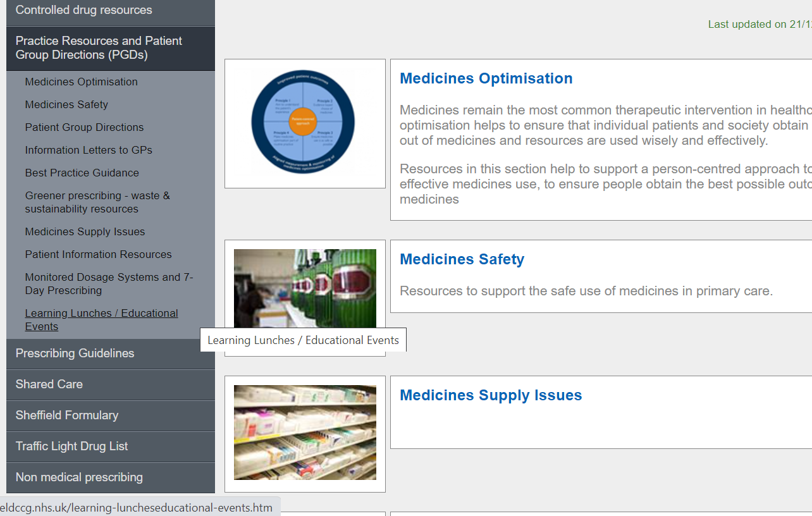
Missed the meeting/other learning lunch resources

Slide 4
Learning objectives
To be aware of latest updates & suggested actions to:
Traffic Light Drug List
Formulary – Cardiovascular chapter
Guidelines – self-care guidance
Medicines Supply Problems
Medicines Safety update
General prescribing update; and
Education &Training opportunities

Slide 5
Traffic Light Drug List
A single SY ICB TLDL is in the process of being developed (SY IMOC). Please continue to refer to both Sheffield place and SY ICB TLDLs
To access both SY ICB TLDL and Sheffield place TLDL: Sheffield place intranet > Medicines and Prescribing > TLDL
Dekas plus liquid - a vitamin supplement for use in patients aged under 3 years with cystic fibrosis, classified as GREEN ( for all other indications classed as GREY)
Morphine Sulphate 100 microgram/ml oral solution for pain relief, classified as RED
Chickenpox vaccine: Varilrix®,Varivax® prior to immunosuppression in both adults and children classified as RED 6
Optimise Rx will be updated to reflect TLDL status of medicines where relevant, so clinician is aware at the point of prescribing

Slide 6
Self-care guidance updated – now approved by SY IMOC SY_ICB_Self_Care_Guidance_V1.0.pdf (syics.co.uk)
SYICB has made the decision to adopt all the recommendations within the NHSE guidance.
The full NHS England guidance is available at: https://www.england.nhs.uk/wp-content/uploads/2018/03/otc-guidance-for-ccgs.pdf
The guidance is intended to encourage people to self-care for minor illnesses as the first stage of treatment.
The guidance is not intended to discourage patients from going to the GP when it is appropriate to do so. Information has been added that this should not restrict safe access to necessary medicines for vulnerable people,
More information on OTC restrictions is available in the table and in PrescQIPP bulletin 227: Over the counter items - GP guide to self care (Users need to log to access this resources.
Information added around different care settings, including for care homes and homely remedies and when a resident, relative or care staff purchases an OTC medicine

Slide 7
Sheffield Formulary Changes
Cardiovascular System
Section 2.4- Beta-adrenoceptor blocking drugs
Beta blockers are now step 4 in the management of resistant hypertension.
However, they may be considered earlier in the pathway in younger people, see formulary for more information and NICE NG133 for place in management of hypertension in pregnancy.
Section 2.5- 6.1.2.3 Sodium glucose co-transporter inhibitors (SGLT2 inhibitors)
Addition of dapagliflozin and empagliflozin in Heart Failure with Reduced Ejection Fraction (HFrEF) in patients with and without Diabetes Mellitus.
AMBER on the TLDL specialist initiation required for treating symptomatic HFrEF. Dapagliflozin in HFrEF: guidance for primary care (guidance under review to include empagliflozin)
GREEN on the TLDL for management of CKD. Dapagliflozin 10mg daily ( Sheffield CKD guidance for primary care under development)
Section 2.6.3 Other antianginal drugs
Addition of ranolazine 2.5mg as this is AMBER on TLDL for people who are intolerant to other therapies, in line with the Sheffield treatment algorithm.

Slide 8
Section 2.9 Antiplatelet drugs
Danamep 75mg (aspirin) removed as preferred brand
Aspirin 300mg removed as only initiated by specialist in secondary care, in line with antiplatelet guidance
Prasugrel and ticagrelor added , along with Rivaroxaban 2.5mg added as an antithrombotic drug – AMBER on TLDL
Section 2.12 Lipid-regulating drugs
Updated links to Sheffield lipid modification guidelines & added link to raised triglycerides flow chart.
rosuvastatin addition (not capsules)
Cholesterol absorption inhibitors (new additions): bempedoic acid/ezetimibe added as GREEN on TLDL and bempedoic acid montherapy added as AMBER on TLDL
Fibrates added as AMBER on TLDL
Inclisiran added – GREEN on TLDL
Omega-3-fatty acid compounds: Icosapent ethyl added as AMBER on TLDL
PCSK-9 inhibitors (evolocumab & alirocumab) Added as RED on TLDL, so all products recommended in the update lipid modification guidelines are listed.
The TLDL status of these medicines is reflected by Optimise Rx at point of prescribing

Slide 9
Sheffield Formulary
Chapter 6: Endocrine System update
Insupen Original now first choice for insulin pen needles, followed by
BD Viva
GlucoRx CarePoint have been removed from the formulary
Sheffield Formulary updated choices:
6.1.1.3 Hypodermic equipment
Needles
Insupen Original needles 4mm, 5mm, 6mm
BD Viva needles 4mm, 5mm, 6mm
Here is the link for the for the formulary chapter 6_Endocrine.pdf (sheffieldccg.nhs.uk)
All new patients that require insulin, please prescribe Insupen Original pen needles

Slide 10
Alimemazine solution
Sheffield Preferred brand
Alimemazine is a first-generation antihistamine and licensed for urticaria and pruritus.
In Sheffield alimemazine is used off label, initiated from Sheffield Children’s Hospital for:
Retching, initiated by gastroenterology team and mainly lower doses i.e., 7.5mg/5ml solution; and
Sleep disorders where the higher strength is used i.e., 30mg/5ml solution.
Not currently listed on the TLDL, but this is under review.
To ensure this is prescribed most cost effectively, Sheffield’s preferred brand for the solution is called Itzenal® SF – and specialist letters should specify this brand.
Medicine Optimisation Team are undertaking some of the switches to the brand Itzenal®.

Slide 11
Medicines Supply Problems - Sheffield Place
ADHD national shortage – Sheffield place information and patient information on this Medicines Supply Page.
Riluzole: Advice Regarding Riluzole Supplies in the Community
Where there are supply problems with generic riluzole in the community,
Suggested Actions are:
Community pharmacists to contact prescribers to temporarily amend / issue as an acute prescription either Emylif®, Rilutek® or Teglutik®.
For Primary care clinicians: If patients report that unable to get supplies from community pharmacy, issue acute prescription as either Emylif®, Rilutek® or Teglutik®; liaise with community pharmacist to confirm supplies / liaise with patient etc,
Once supplies of generic riluzole return into stock, to switch patients back to generic

Slide 12
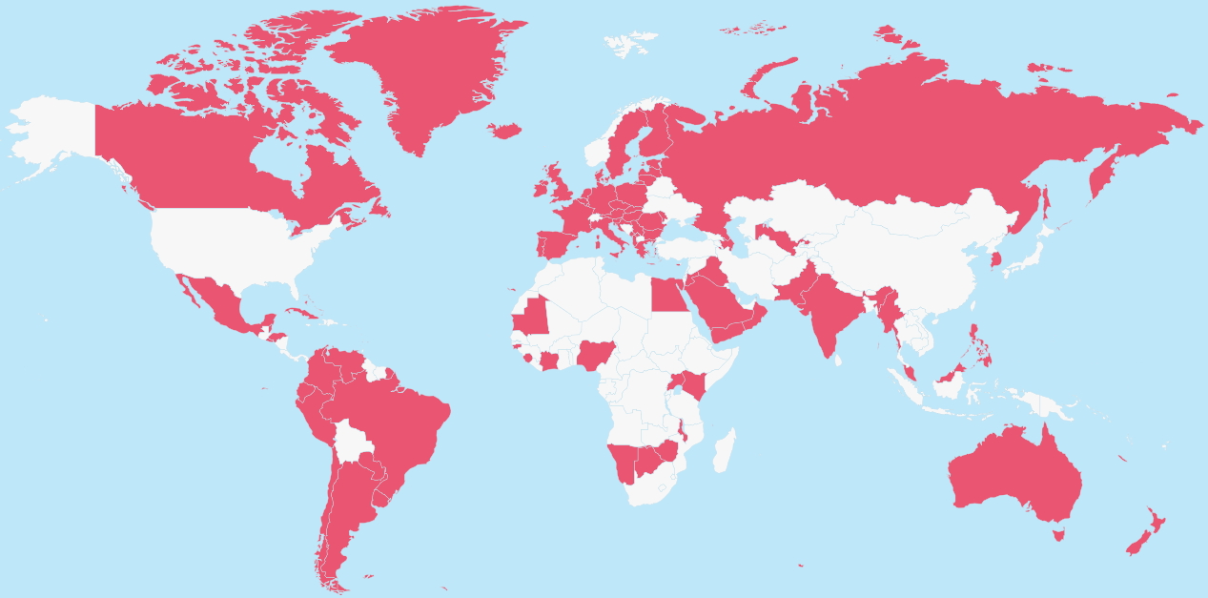
Annual #MedSafetyWeek 2023 (6-12 November)
#MedSafetyWeek is a global social media campaign to encourage the reporting of suspected side effects.
The theme for 2023 is ‘Who can report?’
All patients, carers, and healthcare professionals can contribute and play a key role in improving patient safety and strengthening the vigilance of healthcare products.
Never delay in reporting suspected side effects or adverse incidents to a medicine, vaccine or medical device to the Yellow Card scheme – only a suspicion is needed to report a suspected reaction.
What healthcare professionals can do to support #MedSafetyWeek:
Follow MHRA social media channels during the week – retweet, comment, like and share safety messages using #MHRAYellowCard, #MedSafetyWeek, #PatientSafety and #ReportSideEffects
Raise awareness locally and encourage reporting – new materials are available, including downloadable digital and print posters, social media banners and animations. See https://yellowcard.mhra.gov.uk/MedSafetyWeek
Have conversations with colleagues and patients about side effects and how they can report suspected problems to the MHRA Yellow Card Scheme or via the Yellow Card app (download from the Apple App Store or Google Play Store)
Accredited e-learning modules are available for doctors, pharmacists and nurses which count for CPD credits. See https://yellowcard.mhra.gov.uk/resources/elearning
For more detailed information, see the MHRA Drug Safety Update, the Yellow Card website and the Uppsala Monitoring Centre’s website
To discuss supporting the campaign locally or for more information, contact the South Yorkshire ICB Medicines Safety Officer (MSO): syicb-sheffield.mso@nhs.net
94 organisations
83 countries
50 languages

Slide 13
New SPS resources (link here)
Refrigerated medicines stability tool
Advice on whether refrigerated medicines can or can’t be used after exposure to out-of-range temperatures. Find entries and build and print lists.
Using laxatives during breastfeeding (Published 24 October 2023)
Any laxative can be used during breastfeeding although prucalopride should be used with caution. Recommendations apply to full term and healthy infants.
Giving vaccines during breastfeeding (Published 26 October 2023) All vaccinations, including live vaccines, can be given during breastfeeding. The only exception is yellow fever vaccine which is not recommended.
Medication Safety Update (Last updated 25 October 2023)
Update: October slide deck collating the latest medication safety communications and publications to inform, support and inspire medication safety improvements.

Slide 14
SPS webinar - Reviewing medicines for people at risk of falls
Date: 9 January 2024, 13:00 - 14:00, online.
What will be covered/what you will learn
The importance of medication in causing falls
How medication reviews can reduce falls risk
Information and guidance that can be used in conducting a falls-related medication review.
Speakers
Ðula Alićehajić-Bečić - Consultant Pharmacist Frailty, Wrightington, Wigan and Leigh NHS Foundation Trust
Heather Smith - Consultant Pharmacist: Older People, NHS West Yorkshire Integrated Care Board.
Registration is now open

Slide 15
PrescQIPP updates / new bulletins
Bulletin 314 launched - Liothyronine | PrescQIPP C.I.C
Bulletin 326: Documenting outcomes from medication review | PrescQIPP C.I.C
Bulletin 330 launched - Antidepressants | PrescQIPP C.I.C
Please note
Liothyronine - Current guidance local is under review as there is new national NHS guidance.
Antidepressants – will shortly be publishing updated local depression guidance

Slide 16
prescqipp-resource-guide-october-2023.xlsx (live.com)
Useful resource page:
Leadership at lunch 2023/24 (one registration link for all the sessions) Nov, 15 Dec 2023 , 9 Feb, 19 Apr, 7 Jun, 12 Jul 2024 | 10/11/23 | https://attendee.gotowebinar.com/register/5903411404386958942
Pharmacy Technicians VPG | 13/11/23 | https://attendee.gotowebinar.com/register/1090203596662436951
Clinical Masterclass - Pharmacogenomics: Is it time for implementation into clinical practice? | 14/11/23 | https://attendee.gotowebinar.com/register/6027858527539437911
PrescQIPP carbon awareness and sustainability in healthcare webinar series (started 28 Sept followed by 19 Oct) the last three planned for 14 Dec 23, 18 Jan 24 and 15 Feb 24 | 23/11/23 | https://attendee.gotowebinar.com/register/3625254096592417879
Practice Plus webinar | 29/11/23 | https://attendee.gotowebinar.com/register/7324079376885629197
Champions | 06/12/23 | https://attendee.gotowebinar.com/register/4004836292024573792
Silver Award Winner - Antidepressant deprescribing clinic - NHS South Yorkshire | 11/12/23 | https://attendee.gotowebinar.com/register/1724495362426075481
Practice Plus webinar (details not finalised to this link yet) | 13/12/23 | https://attendee.gotowebinar.com/register/6611142843786758742
Clinical Masterclass - Eczema management in primary care | 19/12/23 | https://attendee.gotowebinar.com/register/7332666568451736411

Slide 17
World Antimicrobial Resistance (AMR) Awareness Week 2023
Global campaign to raise awareness and understanding of AMR and promote best practice
Will be held 18th - 24th November.
The main theme this year is ‘preventing AMR together’
Five different daily themes during the week
3 webinars will be publicised nearer the time aimed at clinicians
World Antimicrobial Resistance Awareness Week (WAAW) and European Antibiotic Awareness Day (EAAD) - GOV.UK (www.gov.uk)
To view your practice’s prescribing of antimicrobial agents, visit Open Prescribing. Prescribing measures for NHS SHEFFIELD | OpenPrescribing shows the ratio of broad-spectrum antibiotics prescribed compared to total antibiotic use. Will assist with PQIS (clinical metric component 2).

Slide 18
Summary of key actions
Add
Add any RED medicines prescribed by hospital as ‘hospital only medicines’ – not on repeat; and please share with others that we have two TLDLs
Share/follow
Share/ publicise with colleagues the updated cardiovascular formulary chapter
Share/highlight
Update
Colleagues with recent medicines supply problems: ADHD treatments and riluzole –see suggested actions:
Check out
Check out learning opportunities from PrescQIPP and SPS (webinars free to attend – e.g.Antibiotic awareness) & PrescQIPP bulletins, SPS resources. Also see Medicines Safety week : raise awareness locally and encourage reporting plus accredited learning opportunities
New Insupen Original is now first choice insulin pen needles, followed by BD Viva
Alimemazine brand of choice is Itzenal® SF

Slide 19
Next APG– Learning Lunch
Click here to join the meeting
Weds 6 December 2023
Feedback welcome https://forms.office.com/Pages/ResponsePage.aspx?id=slTDN7CF9UeyIge0jXdO443oflYckS5GlHWzOtEesnlUMDNDTkRVTDI1VTRaV1dPQlhMRFAyTkxNNy4u

Slide 20
Questions?

