Slide 1
Welcome - We will start at 12:30 Area Prescribing Group – Learning Lunch 4th October 2023 Sheffield Medicines and Prescribing
Notes:
Please Note: Ensure that slides will be understood by those not present at meeting and remember to include hyperlinks as much as possible, i.e. less is more. From now on, APGLlunch will be sent as PDF to primary care clinicians and will replace the APG Round Up

Slide 2
Introductions
Helen Taylor – Clinical Effectiveness Pharmacist
Emily Parsons – Medicines Governance Pharmacist
Augustinas Slucka – Clinical Practice Pharmacist
House Keeping
Feedback welcome – see form in chat

Slide 3
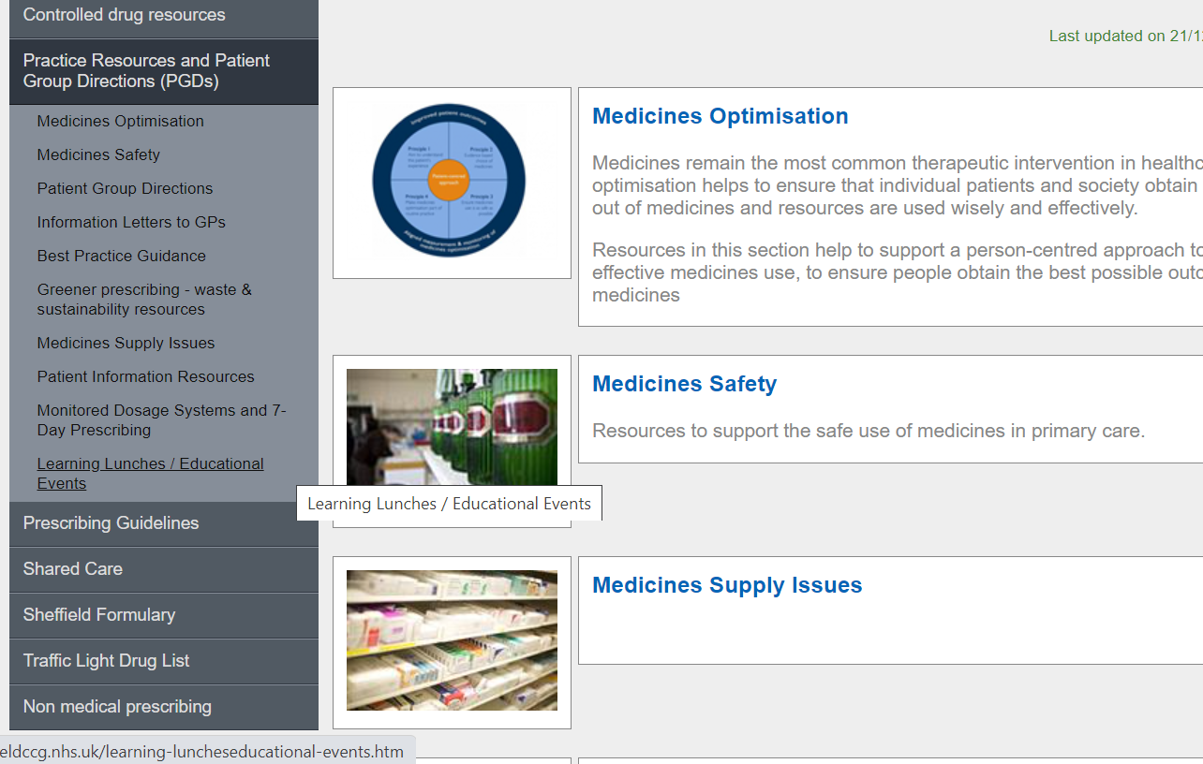
Missed the meeting/other learning lunch resources
Notes:
DO we delete this slide ? And place in separate place.

Slide 4
Learning objectives
To be aware of latest updates & suggested actions to:
Traffic Light Drug List update
Formulary update
Guidelines
Anxiety guideline & bath Emollients - Augustinas Slucka
Specials document updated
Medicines Safety update - Emily Parsons
General prescribing updates
ADHD Medicines Supply (CAS alert Sept 23)
Education & Training opportunities

Slide 5
Traffic Light Drug List
A single SY ICB TLDL is in the process of being developed.
All new TLDL approvals are only added to SY IMOC TLDL.
Sheffield Place is only be updated as drugs are removed (i.e move across to SY IMOC TLDL)
Please continue to refer to both Sheffield place and SY ICB TLDLs
To access both SY ICB TLDL and Sheffield place TLDL: Sheffield place intranet > Medicines and Prescribing > TLDL
IMOC SY TLDL has been updated to September 2023. Optimise Rx will be updated with all medicines on TLDL as Amber, Amber G, Red and Grey but please continue to check IMOC and Sheffield place TLDL

Slide 6
Sheffield Formulary Changes (link)
Continuing with place-based formulary
Chapter 6: Central Nervous System (updated version now on intranet) – Key changes
Pain, N&V, Migraine update covered in July APG LL
Anxiety: Grey box information:
Clearer message to avoid long-term use, and that use of benzodiazepines to treat short-term ‘mild’ anxiety is inappropriate.
To support safer prescribing added: Limit to the lowest dose and duration and extra caution should be taken when prescribing to patients with alcohol and drug misuse and marked personality disorder patients.
Added to gain and document informed consent should be obtained and documented when SSRI is used off-licence
Tapering advice updated to: NICE CKS: Benzodiazepine and z-drug withdrawal, BNF and NICE NG215
See links on Sheffield Formulary to local resources and services to support safer prescribing of benzodiazepines. Open prescribing link to see prescribing

Slide 7
Chapter 6: Central Nervous System (updated version now on intranet) – Key changes
Depression
Updated in accordance with NICE NG222. New classification: less severe and more severe depression.
In less severe depression psychological support should be offered prior to prescribing antidepressants, but not withheld if the patient prefers the option or psychological interventions cause a delay to the treatment.
To increase safety: When prescribing to patients 18 - 25 years or at risk of suicide assess prior to starting prescription, 1 week after starting antidepressant or increasing dose, review again after this as needed, but no later than 4 weeks. Consider toxicity in overdose.
Updated wording: Sertraline – formulary choice in patients with a recent myocardial infarction or unstable angina. See SPS for Choosing an antidepressant people with coronary heart disease
Antidepressant withdrawal: NICE CKS Switching antidepressants, SPS SSRIs to other antidepressants: switching in adults and RCPSYCH Stopping antidepressants
Clozapine
More information added regarding clozapine blood tests. The Michael Carlisle Centre clozapine blood clinic is responsible for bloods. All clozapine prescribing is done by the specialist. Bloods must be sent to the lab using the prefilled form from the Michael Carlisle Centre clozapine blood clinic. Information including contact details have been added on where patients can attend to have bloods.

Slide 8
Prescribing Guideline update: Generalised Anxiety Guideline (GAD)
Note: Guideline to be added to Intranet and link On Press Portal still to be updated
Main changes include: New format and updated links; Interlinking with services around Sheffield and NICE guidelines.
Notable clinical changes:
Do not: Offer benzodiazepine for the treatment of GAD except for short-term relief (maximum 2-4 weeks) during crisis or for severe disabling anxiety. (Sheffield Formulary: added ‘Avoid long-term use. Use of benzodiazepines to treat short-term ‘mild’ anxiety is inappropriate’).
Antipsychotic therapy is not recommended in primary care anymore
Added cocaine interaction and serotonergic drug interaction
Advice on overdose in high-risk patients added (beta-blockers)
Added link to NICE visual summaries for medication associated with dependence and withdrawal
Tapering guidance added in the guideline
Ensure short-term use of benzodiazepines (not on repeat)
Monitor quantities of drug supplies in high-risk patients e.g. beta-blockers

Slide 9
Sheffield Formulary Changes (link)
Chapter 13 Skin
Bath emollients and additives: Will not be prescribed by primary care, unless recommended by specialist dermatology services (STH, SCH)
Minor updates: Abbreviated emollient guide outlines alternatives for bath additives and soap substitutes that can be used instead of original products
Do not prescribe costly bath additive products and use emollients as an alternative instead

Slide 10
Specials guideline
Guidance on prescribing Specials – Approved by FSG (May) under the delegated authority of APG and minor amendments by virtual approval June 2023 – Published to be publicised.
Specials are a category of unlicensed medicines manufactured for individual patients specifically to meet their clinical needs.
The use of a special should only be considered when the use of a licensed preparation is not possible.
Specials are usually significantly more costly compared with standard preparations.
EPACT data shows that approximately 2700 items per annum for a special medicine are prescribed in Sheffield, costing approximately £200,000
MOT produce quarterly reports showing specials prescribing per practice
Review specials prescribing as per MOT report to consider if there are licensed and more cost-effective alternatives available

Slide 11
Medicines Safety
Local updates
Fire hazard warning: Emollients – document updated
The MOT guidance document has been updated to include updated MHRA guidance which warns of fire risk with all emollients, not just emollients containing paraffin.
Link to the South Yorkshire Fire and Rescue website. Patients or healthcare professionals can request home safety visits for people who are considered to be at particular risk of fire.

Slide 12
Medicines Safety - continued
MHRA Drug Safety Updates
Fluoroquinolone antibiotics
Reminder of the risk of disabling and potentially long-lasting or irreversible side effects
Reminder of the risk of disabling and potentially long-lasting or irreversible side effects (musculoskeletal, nervous, psychiatric, sensory). Do not prescribe for non-severe/self-limiting infections unless no alternative available.
Open prescribing shows 582 items of ciprofloxacin (systemic) prescribed in Sheffield in June 2023; 2458 items in the last 12m. Supply sheet for patients when prescribing
Optimise Rx warning for prescribing not in line with NICE/UKHSA guidance: 'Ciprofloxacin is only recommended first-line for a limited number of infections due to risk of antimicrobial resistance and serious side effects.’
Suicidal thoughts and behaviour
Reminder to be alert to the risk of psychiatric reactions, including depression and psychotic reactions, which may potentially lead to thoughts of suicide or suicide attempts.
Methotrexate: advise patients to take precautions in the sun to avoid photosensitivity reactions
Advise patients to take precautions in the sun to avoid photosensitivity reactions.
The methotrexate SCP has reached its review date and it currently being updated to include this warning.
Statins: very infrequent reports of myasthenia gravis
Very small number of reports of new-onset or aggravation of pre-existing myasthenia gravis with statins

Slide 13
Apixaban and reduction in price of generic
We are aware of a reduction in cost of generic apixaban, as per October Drug Tariff.
However, there is an on-going legal process regarding the patent of apixaban with the next update due October 23.
In line with current national and local recommendations for patients commencing treatment for AF: subject to the criteria specified in the relevant NICE technology appraisal guidance, clinicians should use edoxaban where this is clinically appropriate.
Whilst we are waiting for further clarity on the patent process, we do not recommend changing a patient’s treatment from one DOAC to another, unless there is a patient specific clinical or safety reason to do so.
Don’t switch from one DOAC to another, unless there is a patient specific clinical reason

Slide 14
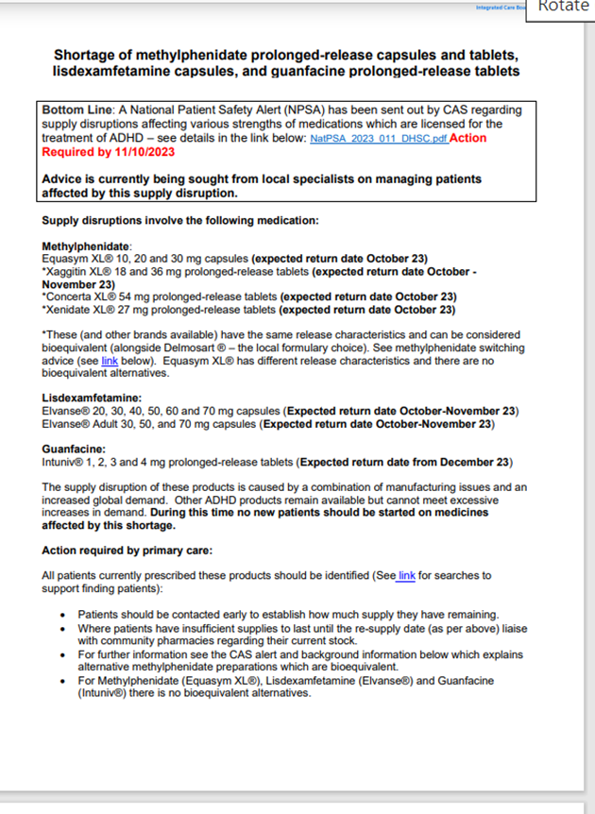
ADHD Medication and shortages
GP practice bulletin:
CAS-ViewAlert (mhra.gov.uk) and SPS supply monitoring tool (registration required) has estimated re-supply dates (short term supply problem).
Searches available on clinical practice systems to identify patients prescribed affected ADHD medicines.
Primary care should be making early contact with patients to establish how much supply they have remaining, and liaising with pharmacies.
Xaggitin®, Delmosart®, Xenidate® and Concerta®: key message – considered bioequivalent. Ensure patients (and/or carers) have any changes communicated to them; and are advised to seek medical advice if any change in effect.
Equasym® - no bioequivalent alternative. Limited parallel imports which not able to support uplift required.
Elvanse® and Guafancine® - some specialist importers have confirmed they can source unlicensed imports. MOT currently liaising with community pharmacy to find out if these are available.

Slide 15
ADHD Medication and shortages
We are working with local specialists on producing advice for patients who are unable to be changed to a bioequivalent alternative; and who may run out of their medication before the re-supply date.
We are seeking advice from local specialists on this; but as this is a short-term supply problem it may be more beneficial for a patient to have a short break from ADHD medication than to consider an alternative.
Guanfacine (Intuniv®): Due to the risk of rebound hypertension when stopping guanfacine treatment it should be titrated down ideally by 1mg every 3 – 7 days prior to stopping. The patients` blood pressure and heart rate should be monitored weekly during this period.
The Medicines Optimisation Team will be seeking practice permission to identify patients > 18 years old and prescribed guanfacine who are / have been under care of SHSC or SAANs; and to feed this information back to a SHSC specialist.
Action: use searches to identify patients as per the CAS alert. Local specialist advice is being sought .

Slide 16
New SPS resources (link here)
Switching between oral prednisolone and IV hydrocortisone (Published 29 September 2023)
Switching between oral prednisolone and intravenous (IV) hydrocortisone requires care due to the risk of adrenal insufficiency or adrenal crisis.
Using intramuscular injections in people on oral anticoagulants (Published 20 September 2023)
Advice on risks related to use of small volume (less than 3mL) intramuscular (IM) injections in people on oral anticoagulants (for example, DOACs, warfarin)
Note: This is a merger of two previous pages entitled: Small volume intramuscular injections in people taking oral anticoagulants and Using COVID-19 vaccines in patients with anticoagulation and bleeding disorders.
Using clopidogrel with proton pump inhibitors (PPIs) (Last updated 14 September 2023)
Update: Minor update to reflect updated NICE CKS advice regarding risk factors for gastrointestinal bleed
Considerations when switching between solid doses and liquids (Published 13 September 2023)
Bioavailability, release profile and licensed uses are some of the considerations needed when changing between solid dose and liquid formulations.

Slide 17
PrescQIPP updates / new bulletins
PrescQIPP IMPACT flyer Improving Medicines and Polypharmacy Appropriateness Clinical Tool (IMPACT) bulletin.
12th October 1-2pm, Katie Smith, Director of Clinical Quality at PrescQIPP and Lelly Oboh, Consultant Pharmacist (Care of older people) will demonstrate how to utilise IMPACT when doing a medication review (Lelly has considerable experience of optimising medicines use in frail older people).
Register here
PrescQIPP work plan 2024 - 26- submit your requests now
This part of the consultation will close on Monday 16th October 2023: https://airtable.com/appo4TXuklrYwaWGI/shrqSWzBC3iNVOmkd
Before you submit your ideas, we would recommend you download our resources guide https://www.prescqipp.info/media/6727/prescqipp-resource-guide-july-2023.xlsx to see what we already have available. We also recommend taking a look at our current 2 year work plan https://www.prescqipp.info/media/6481/prescqipp-work-plan-2023-25-final.pdf to see what’s coming soon. If you feel that a current resource does not meet your needs, let us know in the scope how to improve it and what you would like to see included as part of an update to that resource.

Slide 18
Next APG– Learning Lunch
Thursday 2 November
Click here to join the meeting
Feedback welcome https://forms.office.com/Pages/ResponsePage.aspx?id=slTDN7CF9UeyIge0jXdO443oflYckS5GlHWzOtEesnlUMDNDTkRVTDI1VTRaV1dPQlhMRFAyTkxNNy4u
Wednesday 6th December Click here to join the meeting

Slide 19
Questions?

