Slide 1
Welcome - We will start at 12:30 Area Prescribing Group – Learning Lunch 17 April 2024 Sheffield Medicines and Prescribing
Notes:
DO we then remove this slide when we publish it on the intranet ?

Slide 2
Introductions
Helen Taylor – Clinical Pharmacist
Barbara Obasi – Clinical Effectiveness Pharmacist
Emily Parsons – Medicines Governance Pharmacist
House Keeping
Feedback welcome – see form in chat

Slide 3
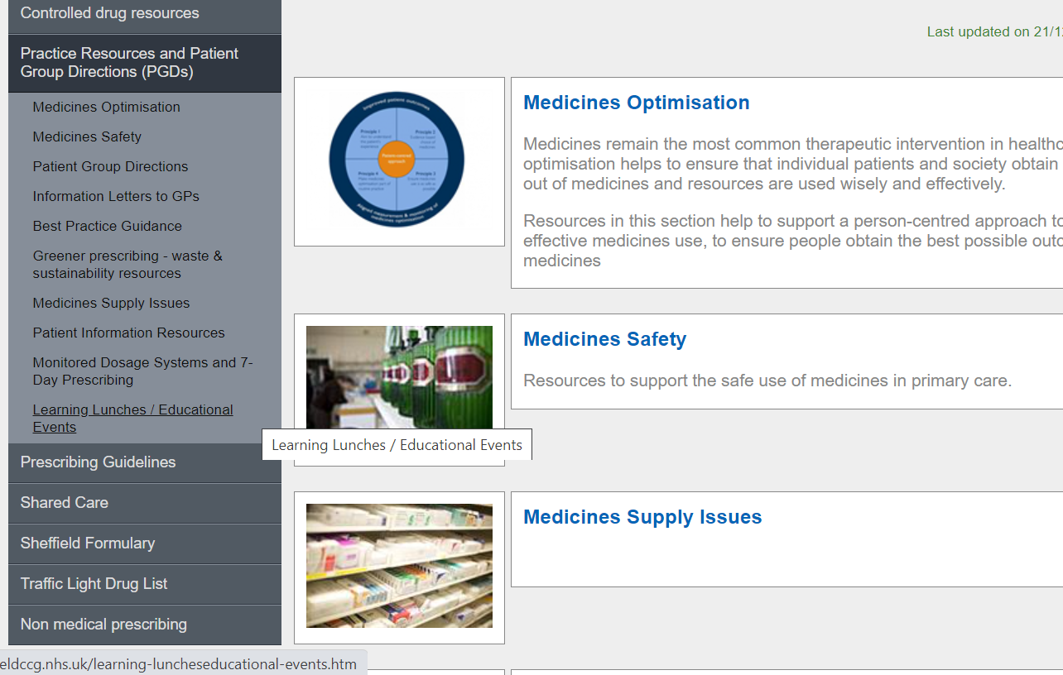
Missed the meeting/other learning lunch resources
https://www.intranet.sheffieldccg.nhs.uk/medicines-prescribing/learning-luncheseducational-events.htm
Notes:
DO we delete this slide ? And place in separate place.

Slide 4
Learning objectives
To be aware of latest updates & suggested actions to:
Traffic Light Drug List
Share care protocols
Formulary
Medicines Safety update
General prescribing update
Education &Training opportunities

Slide 5
Traffic Light Drug List
A single SY ICB TLDL is in the process of being developed (SY IMOC). Please continue to refer to both Sheffield place and SY ICB TLDLs
To access both SY ICB TLDL and Sheffield place TLDL: Sheffield place intranet > Medicines and Prescribing > TLDL
Drug | Indication | SY ICB Traffic Light Status
Doxylamine & Pyridoxine (Xonvea®) | Nausea and vomiting during pregnancy | Green
Antimalarials | Prophylaxis treatment of malaria | Grey (2)
Tirzepatide (Mounjaro KwikPen® ) | Weight management indication | Grey (6)
Azathioprine | In line with Place’s shared care protocols, preparations within the documents. Cross reference to Grey traffic light status for high strengths (75mg &100mg) | Amber (1,2 ab)
Azathioprine 75mg & 100mg strengths |  | Grey (3)
Optimise Rx will be updated with all IMOC approved TLDL changes.
Avoid adding any RED medicines prescribed by hospital to patient’s repeat record. Add as ‘hospital only drug’
Notes:
Focus currently is on aligning the GREY list medicines across the 4 places. Recent case(s) where RED medicines issued accidentally as placed
On repeat Rx

Slide 6
Medicines Safety
MHRA and other national alerts
Sodium chloride 0.9% solution - urgent product recall
Potential contamination with Ralstonia pickettii (R. pickettii) has been identified in 0.9% sodium chloride solutions used for irrigation, inhalation and eyewash. Products recalled within the FSN may be sold individually or as parts of equipment kits (ranging from aseptic clinical equipment packs to first aid kits used outside clinical settings).
All recalled batches need to be immediately quarantined and returned to the manufacturer.
Review your inventory of 0.9% sodium chloride solutions intended for irrigation, inhalation and eyewash, and determine if any of the batch numbers listed in the FSN are present in your stock.
Counterfeits and unbranded copies of LifeVac anti-choking devices may fail to work correctly or worsen choking incidents if used
Anti-choking devices are intended to alleviate choking incidents after Basic Life Support protocols have been attempted and failed. There are numerous counterfeit and unbranded anti-choking devices being sold in the UK online which do not have a valid UKCA or CE mark and may pose a significant risk of worsening choking if used. These devices should not be used in the event of a choking emergency and should be disposed of once identified as counterfeit or non-compliant.
Healthcare professionals, especially those working in care settings, health visitors or those working with parents in the community, should consider the need to promote details of the alert.
NatPSA: Potential contamination of some carbomer-containing lubricating eye products – March Update
As of 21 March 2024, the UKHSA and the multi-stakeholder Incident Management Team are satisfied that the risk associated with this outbreak has reduced. The MHRA are satisfied that carbomer-containing lubricating eye products available on the UK market are safe to use in all patients.
The other recommendations within the NatPSA remain.

Slide 7
Medicines Safety
Azathioprine tablets 75 mg & 100 mg
Classified as Grey (criteria 3) on the SY ICB TLDL
25mg & 50mg tablets are amber on place TLDLs for indications included on SCPs
Rationale:
Risk of confusion by patients and clinicians with potential risk of accidental overdose or underdose
Cost implication
Supported by secondary care in Sheffield and Community Pharmacy SY
Extra advice:
Include a total daily dose on all prescriptions
Avoid prescribing in half tablets
OptimiseRx will be updated to support prescribing of the lower strengths

Slide 8
Palliative care – shortage of hyoscine butylbromide 20mg/ml injection (Buscopan®)
This is prescribed as a pre-emptive medicine in palliative care for respiratory secretions.
Been out of stock at wholesalers for a few weeks. Logistical issue now resolved, and Sanofi confirm will be at wholesalers by latest 25 April 24.
The Wicker Pharmacy currently has stock of hyoscine butylbromide 20mg/ml injection.
Alternative is: Glycopyrronioum bromide injection 200mcg/ml (3ml ampoule).
Sheffield Palliative Care Formulary: https://nww.sth.nhs.uk/STHcontDocs/STH_CGP/PalliativeCare/SheffieldPalliativeCareFormulary.pdf
For specialist palliative care advice contact St Luke’s Hospice, Community Palliative Care Team on: 0114 2369911

Slide 9
New SPS resources (link here)
Treating heartburn and dyspepsia during breastfeeding
Using gastrointestinal antispasmodics during breastfeeding
Treating insomnia during breastfeeding
Treating rectal and anal disorders during breastfeeding

Slide 10
Education and Training
The Prevention of Type 2 Diabetes and The Ambition for Remission - The Flagship NHS Diabetes Prevention and NHS Path to Remission Programmes
Wed 24th April 2024, 1pm-2pm
All registered subscribers can sign up here.
Primary care discussions: HRT use in clinical practice
Wed 24th April 2024, 1pm – 2pm Online via WebEx
Registration is now open
Polypharmacy Action Learning Set Training – NHS England funded Action Learning Sets to help build confidence in, and understanding of, the complex issues surrounding stopping inappropriate medicines safely.
Online interactive course held over three half-days (9.30am –12.15pm) over one month.
Session 1: 17 April 2024
Session 2: 1 May 2024
Session 3: 15 May 2024
Register here.

Slide 11
Education and Training
First Annual South Yorkshire Primary Care Conference. Three different sessions being delivered are as follows: - Challenges Delivering the ABCs – Managing type 2 diabetes in 2024 and beyond – Delivering epidemiology and pathophysiology of obesity
Saturday, 27 April 2024 9am – 3:30pm BST
Location: AESSEAL New York Stadium, New York Way, Rotherham, S60 1FJ
Registration is now open

Slide 12
Summary Key actions
Summary of key Actions
Add
Add any RED medicines prescribed by hospital as ‘hospital only medicines’ – not on repeat; and please share with others that we have two TLDLs
Highlight/discuss
Any medicines safety actions, e.g., Review your inventory of 0.9% sodium chloride solutions intended for irrigation, inhalation and eyewash, and determine if any of the batch numbers listed in the FSN are present in your stock.
Check out
Check out learning opportunities (all of which are free to attend)

Slide 13
Next APG– Learning Lunch
Thursday, 9th May 2024
Click here to join the meeting
Feedback welcome
https://forms.office.com/Pages/ResponsePage.aspx?id=slTDN7CF9UeyIge0jXdO443oflYckS5GlHWzOtEesnlUMDNDTkRVTDI1VTRaV1dPQlhMRFAyTkxNNy4u

Slide 14
Questions?

