Slide 1
Welcome - We will start at 12:30 Area Prescribing Group – Learning Lunch 7 March 2024 Sheffield Medicines and Prescribing
Notes:
DO we then remove this slide when we publish it on the intranet ?

Slide 2
Introductions
Barbara Obasi – Clinical Effectiveness Pharmacist
Sharron Kebell – Specialised Commissioning Pharmacist
Emily Parsons – Medicines Governance Pharmacist
Deborah Leese – Clinical Pharmacist
Helen Taylor- Clinical Pharmacist
House Keeping
Feedback welcome – see form in chat

Slide 3
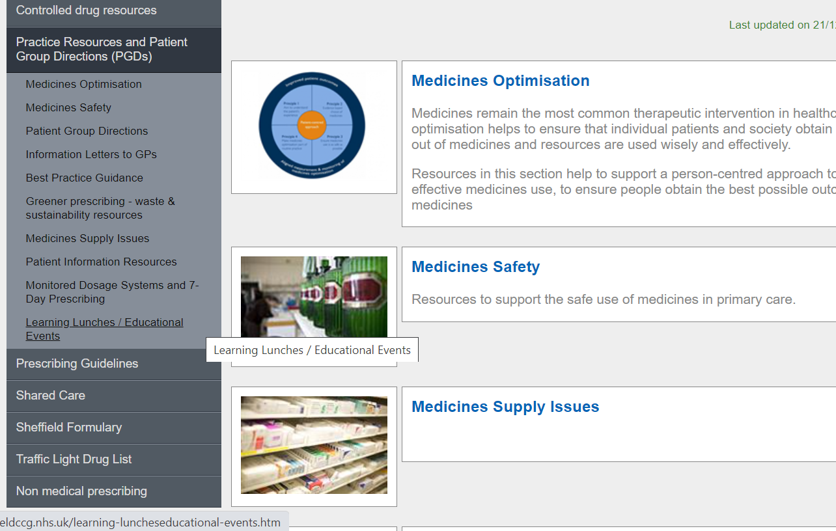
Missed the meeting/other learning lunch resources
Notes:
DO we delete this slide ? And place in separate place.

Slide 4
Learning objectives
To be aware of latest updates & suggested actions to:
Traffic Light Drug List
Share care protocols
Gabapentinoids SY Position Statement
Formulary
Medicines Safety update
General prescribing update
Education &Training opportunities

Slide 5
Traffic Light Drug List
A single SY ICB TLDL is in the process of being developed (SY IMOC). Please continue to refer to both Sheffield place and SY ICB TLDLs
To access both SY ICB TLDL and Sheffield place TLDL: Sheffield place intranet > Medicines and Prescribing > TLDL
Drug | Indication | SY ICB Traffic Light Status
Empagliflozin | chronic kidney disease | Green
Methylphenidate (Meflynate XL®) | Use as part of a comprehensive treatment programme for attention-deficit/ hyperactivity disorder in children aged ≥6 years and adults when remedial measures alone prove insufficient | Amber (1,2,3)
Benperidol | Antipsychotic | Red (1)
Betamethasone Plasters | Corticosteroids (topical) | Amber G
Balsalazide | Ulcerative Colitis | Amber G
Sumatriptan dispersible tablets (Imigran® Radis) | Migraine | Grey (4)
Aciclovir 3% eye ointment | Herpes simplex infection | Amber G
Optimise Rx will be updated with all IMOC approved TLDL changes.
Avoid adding any RED medicines prescribed by hospital to patient’s repeat record. Add as ‘hospital only drug’
Notes:
Focus currently is on aligning the GREY list medicines across the 4 places. Recent case(s) where RED medicines issued accidentally as placed
On repeat Rx

Slide 6
Methotrexate Shared Care Protocol - an Update
Adopted the national methotrexate shared care protocol so format looks different, but content is similar
Now includes off label ophthalmology indications: scleritis and uveitis, however, only involves a small number of patients
In terms of accepting shared care, please note, primary care to respond within 14 days of the request being received by the GP practice, where possible
A new improved version of Metoject® launched in March 2024, the main advantage is that the pen is simply pressed onto the skin, with no actual button to press, instead there is an audible click at the start and end of injection
Please also note recent DMARD training and this link (to recording & power point):
DMARD Update – includes DMARD Clinical system searches and use of the Sheffield DMARD template
Please respond promptly (within 14 days) to requests for shared care
Recommend above training to GP practice staff involved with DMARD prescribing and monitoring

Slide 7
NEW: SYICB_Position_Statement_on_the_Prescribing_of_Gabapentinoids
When managing neuropathic pain
SY ICB does not support the routine long-term (> 3 months)
co-prescribing of opioids and gabapentinoids
for neuropathic or chronic, non-cancer pain in adults.
Evidence for unlicensed use of gabapentinoids for pain outside of a neuropathic pain presentation is
very limited and is not recommended:
Do not initiate gabapentinoids to manage chronic primary pain (NICE NG193)
Do not offer gabapentinoids for managing sciatica or low back pain (NICE NG59)
Several MHRA alerts issued relating to gabapentinoids:
Pregabalin and gabapentin: advice for prescribers on the risk of misuse (Dec 2014)
Gabapentin (Neurontin): risk of severe respiratory depression (Oct 17)
Pregabalin (Lyrica), gabapentin (Neurontin) and risk of abuse and dependence: new scheduling requirements from 1 April (Apr 19)
Pregabalin (Lyrica): reports of severe respiratory depression (Feb 21)
Pregabalin and risks in pregnancy (Apr 22)

Slide 8
Recommendations in position statement to support safer prescribing of gabapentinoids:
Advise patients of likely efficacy and risk of harm (e.g. dependence /risk of withdrawal symptoms).
Prescribing gabapentinoids for neuropathic pain - have a plan to attempt tapering to minimum effective dose or stopping; after a period of stability e.g. 2-3 months or via annual review (SMR)
Patients taking gabapentinoids for non-neuropathic chronic pain (e.g. low back pain) and sciatica should be reviewed with plan to taper and stop as able.
Patients ‘at risk’ of severe respiratory depression consider if adjustment in dose or dosing regimen is required to reduce risk. Regular review with a view to tapering as able (annual review or 2-3 months after dose change).
Opioids and gabapentinoids should not routinely be co-prescribed for the same pain. Clinicians should routinely switch to the second drug, rather than adding it as an adjunct.
Tapering or stopping opioids and gabapentinoids requires careful planning and collaboration with the patient. Find out if any support in your network for people living with chronic pain.
See local deprescribing guidance / PILs. Tapering and stopping | Faculty of Pain Medicine (fpm.ac.uk) https://www.nice.org.uk/guidance/ng215
Searches available to identify at risk groups including co-prescribing of opioids and gabapentinoids (via MOT or Ardens) and consider Ardens template at review.

Slide 9
Respiratory Formulary Chapter - Updated
No inhaler changes – all done in line with previous guideline updates
Cetirizine oral solution removed due to price
Acepiro added as an alternative mucolytic although NACSYS remains
Acetylcysteine
Once daily effervescent tablet as is NACSYS
Lemon flavour
Some supply issues with NACSYS so this will provide an alternative if not available
Some cautions – higher salt content, contains lactose and sorbitol

Slide 10
Update to AAI section - MHRA guidance from June 2023 added
Adrenaline Auto-Injectors (AAIs) - GOV.UK (www.gov.uk)
Infographic – The correct use of AAI’s 17002885_The_correct_use_of_your_Adrenaline_Auto-Injector__AAI__CC_V10.pdf (publishing.service.gov.uk)
Update to oxygen section – no change to process
Referral can be made to the Sheffield Oxygen Service (HOS-AR) for assessment, if oxygen saturations are consistently below 93% on air in a stable phase, via the proforma accessed HERE

Slide 12
Medicines Safety
National Patient Safety Alerts (NatPSAs)
Valproate – action required by 31st January 2024
This alert is for ICBs to action – an Action and Improvement Plan has been produced and NHSE/CAS notified.
General practice and community pharmacy teams should continue to prescribe and dispense valproate as per local SCP agreements.
The valproate PPP for all girls and women of childbearing potential continues to apply.
Secondary care organisations and the ICB have produced action plans to incorporate the new recommendations which will be introduced at initiation/annual review.
Men – new recommendations released by MHRA in January 2024.
National updated documents - Valproate: new safety and educational materials to support regulatory measures in men and women under 55 years of age
SY guidelines are being updated in line with the new regulations
Add SNOMED codes – e.g. Valproate Annual Risk Acknowledgement Form completed (1366401000000107); Pregnancy prevention programme started (1129771000000103); Referral for completion of Valproate Annual Risk Acknowledgement Form (1366381000000107)
Shortage of salbutamol 2.5mg/2.5ml and 5mg/2.5ml nebuliser liquid unit dose vials - action required by 8th March 2024
The Nat PSA has been superseded by MSN/2024/028 issued on 6/3/2024: See https://www.sps.nhs.uk/shortages/shortage-of-salbutamol-2-5mg-2-5ml-nebuliser-liquid-unit-dose-vials/
The supply position of salbutamol 2.5mg/2.5ml and 5mg/2.5ml nebules has improved.
Salbutamol 2.5mg/2.5ml nebules will be in limited supply from mid-April until late June 2024.
Salbutamol 5mg/2.5ml nebules will remain available, however, cannot support an increase in demand.
All pharmacy procurement teams across primary and secondary care should:
ensure licensed supplies of salbutamol 2.5mg/2.5ml and 5mg/2.5ml nebules are only ordered in line with historic demand. Orders will be monitored and excessive orders challenged; and
place orders with their usual wholesaler. Please ensure orders are not duplicated across multiple wholesalers or suppliers.
Additionally, Secondary care NHS provider pharmacy procurement teams should:
continue to place orders for unlicensed imports of salbutamol 2.5mg/2.5ml nebules to provide a buffer stock of 2-4 weeks cover to support during periods of limited supply (see Supporting information).

Slide 13
Medicines Safety
MHRA and other national alerts
Codeine linctus (codeine oral solutions): reclassification to prescription-only medicine
Codeine linctus is to be reclassified from a pharmacy-only medicine (P) to a prescription-only medicine (POM) owing to the risk of dependence, addiction, and overdose.
Pseudoephedrine: very rare risk of posterior reversible encephalopathy syndrome (PRES) and reversible cerebral vasoconstriction syndrome (RCVS)
Patients and caregivers should be advised to be alert to the symptoms for PRES and RCVS, to stop the medication immediately and to seek urgent medical attention if these occur. If someone presents with symptoms of PRES or RCVS, ask about their medication history.
Acenocoumarol/Warfarin and tramadol: concomitant use is not recommended
Coroner’s Reg 28 report highlighted a patient admitted on warfarin who had been prescribed tramadol. At the time of prescribing the INR was 3.3, but when admitted 2 weeks later the INR was 11.6. Reversal medication was prescribed but patient deteriorated and sadly died.
The inquest concluded that the patient died “as a result of a generally unknown interaction between warfarin and tramadol which caused exceptional thinning of her blood” which resulted in an intraparenchymal and subarachnoid haemorrhage.
Interaction warnings were not consistent across commonly used platforms:
Digital BNF updated in January 2024 to include interaction messages between tramadol and warfarin and other coumarin anticoagulants.
SmPCs and PILs of all tramadol products contain warnings; warfarin product information advises that the individual product information for any new concomitant therapy should be consulted for guidance on dose adjustment and therapeutic monitoring. Only the Teva brand includes the tramadol interaction (when updated in 2023).
Clinical systems vary – S1 includes a warning; EMIS Web doesn’t (on 13th Feb). An Optimise Rx alert has been enabled which highlights the interaction and advises concurrent use is not recommended.
In Sheffield – 46 patients in primary care currently prescribed both medications
Guidance – Tramadol is listed in the table of interactions in the Sheffield Anticoagulation Monitoring Service SOP. The SPAF guideline will be updated to include the interaction.

Slide 14
Medicines Safety
Local safety information
JAK inhibitors and Drug Interactions
Most JAK inhibitors (e.g. tofacitinib, baricitinib, abrocitinib, filgotinib and upadacitinib) are metabolised by CYP3A4, therefore interactions with medicinal products that inhibit or induce CYP3A4 is likely. See individual SPCs for more details.
As a result of a recent incident:
Specialists will endeavour to counsel patients about the importance of informing primary care clinicians that they are being prescribed and supplied a specialist drug, which may interact with any newly prescribed drugs.
All hospital only drugs should be added as Specialist Issued drugs on patient records in primary care. This will allow the clinical system to highlight any potentially harmful drug interactions with other medication.
Refer to secondary care specialists for advice where interactions indicate a dose alteration of the specialist drug is required.

Slide 15
New SPS resources (link here)
SSRI suggestions for adults with swallowing difficulties (Last updated 28 February 2024)
Update: Sertraline 100mg/5ml concentrate for oral solution added to Licensed medicines in suitable formulations. Expiry date of citalopram oral drops updated.
Managing temperature excursions (Last updated 28 February 2024)
Update: Clarification of requirement to report vaccine related incidents.

Slide 16
Education and Training
Clinical Masterclass: Insomnia: getting back to better sleep. Mon 25 March 2024, 1pm - 2pm All registered subscribers can sign up here.
Supporting pharmacists with HRT decision making (Part one): Wed 13 March 2024, 1pm – 2pm Online via WebEx
Registration is now open

Slide 17
Education and Training
First Annual South Yorkshire Primary Care Conference. Three different sessions being delivered are as follows: - Challenges Delivering the ABCs – Managing type 2 diabetes in 2024 and beyond – Delivering epidemiology and pathophysiology of obesity
Saturday, 27 April 2024 9am – 3:30pm BST
Location: AESSEAL New York Stadium, New York Way, Rotherham, S60 1FJ
Registration is now open

Slide 18
Summary Key actions
Summary of key Actions
Familiarise
Share
With colleagues the updated Respiratory Formulary Chapter
Add
Add any RED medicines prescribed by hospital as ‘hospital only medicines’ – not on repeat; and please share with others that we have two TLDLs
Highlight/discuss
Any medicines safety actions, e.g. continue prescribing valproate as per shared care and add SNOMED codes; note acenocoumoral/warfarin & tramadol interaction
Searches
Are available to identify at risk groups including co-prescribing of opioids and gabapentiboids (via MOT or Ardens). At review consider using Ardens template and see deprescribing guidance / PILs.
Yourselves with the updated Methotrexate Shared Care Protocol and respond to requests for shared care within 14 days of receipt, if possible.
Check out
Check out learning opportunities (all of which are free to attend)

Slide 19
Next APG– Learning Lunch
Wednesday, 17th April 2024
Click here to join the meeting
Feedback welcome
https://forms.office.com/Pages/ResponsePage.aspx?id=slTDN7CF9UeyIge0jXdO443oflYckS5GlHWzOtEesnlUMDNDTkRVTDI1VTRaV1dPQlhMRFAyTkxNNy4u

Slide 20
Questions?

