Slide 1
Welcome - We will start at 12:30 Area Prescribing Group – Learning Lunch 7th September 2023 Sheffield Medicines and Prescribing

Slide 2
Introductions
House Keeping
Helen Taylor – Clinical Effectiveness Pharmacist
Emily Parsons – Clinical Governance Pharmacist
Shameila Afsar-Baig – Clinical Practice Pharmacist
Feedback welcome – see form in chat
Notes:
Please use chat to ask any questions.

Slide 3
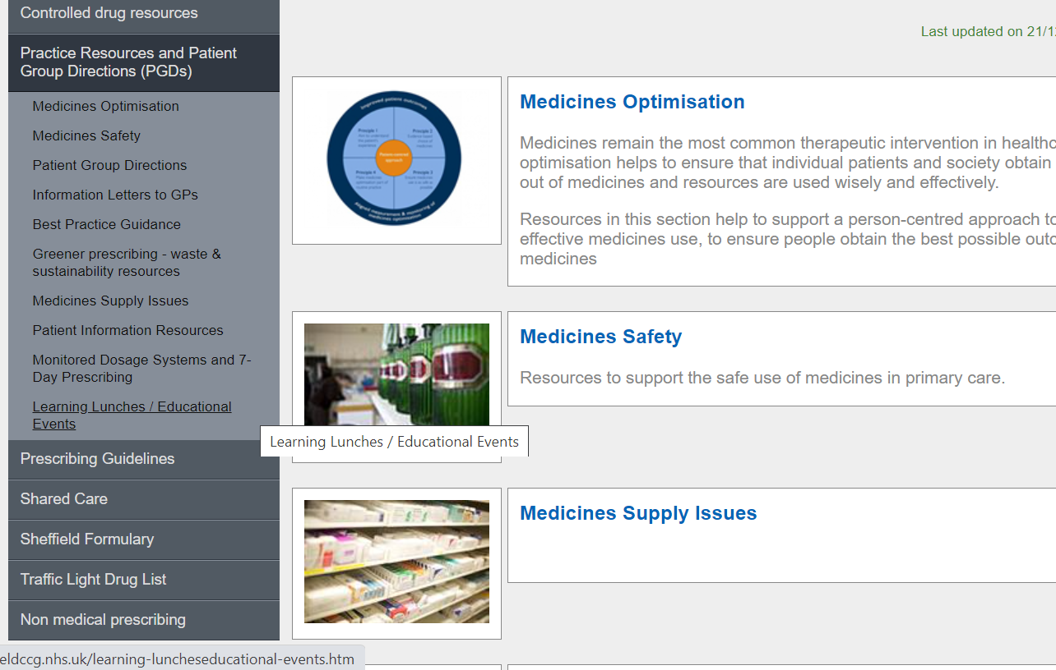
Missed the meeting/other learning lunch resources
Notes:
Past APG LL slides and presentations are added here on the intranet. We are going to stop doing the APG round up shared in the GP e-bulletin as we feeel it’s mainly a duplication of information covered here. We will share the slide set instead

Slide 4
Learning objectives
To be aware of latest updates & suggested actions to:
Traffic Light Drug List
Formulary
Share care protocols
Guidelines – SPAFv3
Medicines Safety update - Emily Parsons
General prescribing update; and
Education &Training opportunities

Slide 5
Traffic Light Drug List
A single SY ICB TLDL is in the process of being developed (SY IMOC). Please continue to refer to both Sheffield place and SY ICB TLDLs
To access both SY ICB TLDL and Sheffield place TLDL: Sheffield place intranet > Medicines and Prescribing > TLDL
June 23 key changes - SY IMOC list:
Atorvastatin 30mg and 60mg tablets (Grey) – Open prescribing
Eflornithine cream (Vaniqa®) Amber G - treatment of facial hirsutism in women
Hepatitis A vaccine (Avaxim Junior®)- Active immunisation against infection caused by hepatitis A virus in children aged 1 to 15 years (Green)
COVID-19 vaccine -Tozinameran + famtozinameran (Comirnaty® Original/Omicron BA.4/5) (Green)
All other IMOC approved TLDL changes are GREY or RED – Optimise Rx will be updated with these changes.
Avoid adding any RED medicines prescribed by hospital to patient’s repeat record. Add as ‘hospital only drug’
Notes:
Focus currently is on aligning the GREY list medicines across the 4 places. Recent case(s) where RED medicines issued accidentally as placed
On repeat Rx

Slide 6
Sheffield Formulary Changes (link)
Chapter 6 :
Prescribing of Oral Bisphosphonates
Risedronate 35mg tablets are now first line choice of Bisphosphonates over Alendronic Acid 70mg tablets:
Risedronate is licensed for treatment of postmenopausal women and treatment of osteoporosis in men at high risk of fractures
Risedronate can be used in slightly lower eGFR (30mL/min). Alendronic acid is contra-indicated eGFR < 35mL/min.
Reminder to review patients prescribed bisphosphonates after 5 years, reassessing fracture risk using relevant tool i.e. FRAX. Refer to NOGG for further guidance.
Continue to review patients on Bisphosphonates particularly after 5 years
Continue to check compliance on regular basis

Slide 7
Sheffield Formulary Changes (link)
Chapter 7 :
Prescribing of vacuum pumps and constrictor rings:
Following assessment and training (written information and a DVD instruction pack on how to use the products and the patient is followed up at 6 weeks to ensure there is no problem in using) by the specialist clinician in secondary care, primary care will be requested to write the prescription for the supply of the pump
Subsequently, only on-going prescription of the constrictor rings is required by the primary care clinician
Alert colleagues to this advice

Slide 8
Shared Care Protocol (SCP) Update:
Topical Testosterone Replacement Therapy in Menopausal Women
Additional Information and responsibilities of clinicians and patients following the MHRA Drug Safety Update (25 Jan 23) on the risk of transfer of topical testosterone and the precautions to be taken
The HRT prepayment certificate, introduced on 1 April 2023, which saves money for those who pay 3 or more HRT prescription charges within 12 months, does not apply to transdermal testosterone products. It only applies to products licensed for HRT, see list here
Recent MHRA alert for Tostran: Class 4 Medicines Defect Information: Kyowa Kirin Limited, Tostran (Testosterone, 2% gel), EL (23)A/33
Healthcare professionals are advised to inform patients that there was a change to the pump/dispenser device supplied with this medicine and the priming instructions prior to use in the current PIL are not accurate.
If the new instructions are not followed then a less accurate first dose may be delivered.
Alert colleagues to this advice
Notes:
Action to reduce the risk of transfer includes advising patients to wash their hands after application of topical testosterone, cover the application site with clothing once the product has dried, and wash the application site before physical contact with another adult or child . HRT prepayment certificate doesn’t apply to this. Currently SPC states to prime the pump depress the actuator 8 times to ensure that the pump is fully primed. The first few depressions may result in no discharge of gel. This has been replaced with depressing the pump until gel is released; and then a further 6 times

Slide 9
Medicines Safety
Febuxostat: updated advice for the treatment of patients with a history of major cardiovascular disease
New trial data suggests that febuxostat can be used with caution in patients with pre-existing major cardiovascular diseases. Particular caution is required in patients with evidence of high urate crystal and tophi burden or those initiating urate-lowering therapy
Non-steroidal anti-inflammatory drugs (NSAIDs): potential risks following prolonged use after 20 weeks of pregnancy
Reminder that use of systemic NSAIDs is CI in the last trimester of pregnancy (after 28 weeks of pregnancy).
Greater warnings/ cautions after 20 weeks due to links with fetal kidney dysfunction, oligohydramnios and constriction of the ductus arteriosus
Avoid systemic NSAIDs from week 20 of pregnancy unless clinically necessary and prescribe the lowest dose for the shortest time. Antenatal monitoring for oligohydramnios should be considered
Levothyroxine and risk of biotin interference on clinical lab tests
Biotin (found in nutritional supplements and complementary medicines) may interfere with thyroid immunoassays that are based on a biotin/streptavidin interaction, potentially leading to inappropriate patient management or misdiagnosis. Patients should therefore be routinely asked about biotin use before ordering thyroid function tests.
Hyoscine hydrobromide patches (Scopoderm 1.5mg Patch or Scopoderm TTS Patch): risk of anticholinergic side effects, including hyperthermia
Reports of serious and life-threatening side effects received particularly when used outside of the licence.

Slide 10
Prescribing Guideline update:
Anticoagulation for Stroke Prevention in Non-Valvular Atrial Fibrillation: Sheffield joint primary and secondary care guidance (SPAF guideline) v3
V3 not yet published. Link will be updated from V2 to V3 shortly
Addition of recommendations from NG196 and Sheffield position statement
Main changes include:
ORBIT tool replaced HASBLED- clinical systems
Edoxaban (first line) Rivaroxaban (second line)
Drug interactions on p4
Extremes of body weight on p6
Patient information / resources on p7
Renal monitoring on p9
Switching between anticoagulants p11

Slide 11
Criteria
Gender | Male | Female
Hb<12g/dl or haematocrit<36% | N=0 | Y=+2
Age >74y old | N=0 | Y=+1
Bleeding history: prev GI, IC or haem stroke | N=0 | Y=+2
eGFR<60ml/min | N=0 | Y=+1
Treatment with antiplatelets | N=0 | Y=+1
Orbit tool- bleeding risk Consider modifiable risk factors
Evidence shows that the Orbit tool has a higher accuracy in predicting absolute bleeding risk than other bleeding risk tools.
Although ORBIT is the best tool for this purpose, other bleeding risk tools may need to be used until it is embedded in clinical pathways and electronic systems.
https://www.mdcalc.com/calc/10227/orbit-bleeding-risk-score-atrial-fibrillation

Slide 12
Formulary choice
Edoxaban first line
Rivaroxaban second line
National procurement agreement in place which allows us to treat more patients with edoxaban than another DOAC.
Where clinically appropriate new patients should be started on this and existing patients can be reviewed for a switch at next review.
Ideally all switches should be discussed with the patient and only switched with the patients agreement, ensure clearly documented.
Note NOT all patients prescribed a DOAC are appropriate for the switch even if AF is the indication.
Eg Cardiology patient where prescriber has specified a specific DOAC for them.

Slide 13
Drug interactions
on p4 updated where clinical data becomes available.
Metabolic interactions via Cytochrome P450/P-glycoprotein vary with each DOAC.
Apixaban mainly metabolised via CYP3A4 so affected by strong inducers/inhibitors
Least interacting DOAC is edoxaban as weakly involved in CYP3A4 metabolism. It’s mainly affected by strong P-gp inhibitors or inducers
Important to monitoring patient esp when new drug are started.
Check SPC/BNF
Check SPAF guideline
Hosp only/specialist drug contact appropriate person for monitoring guidance.

Slide 14
Patient’s weight The ✓ symbolises indicate the drug(s) that are more appropriate due to good trial evidence or having a significant amount of experience with their use.
See SPAF (practical considerations p6)
EHRA and local recommendation
A guide/ One size does not fit all
If in doubt or patient not within parameters seek specialist advice
DOAC | Apixaban | Rivaroxaban | Dabigatran 110mg | Dabigatran 150mg | Edoxaban | Warfarin
Body weight <45kg |  |  |  |  |  | ✓
Body weight 45-120kg and BMI<40kg/m² | ✓ | ✓ |  |  | ✓ | ✓
Body weight 121-150kg and BMI<40kgm² | ✓ | ✓ |  |  |  | ✓
Body weight >150kg or BMI>40kgm² |  |  |  |  |  | ✓

Slide 15
Patient information and resources
Drug information booklets:
A warfarin anticoagulant record (yellow book) can be ordered via NHS Forms or Primary Care Support England (PCSE)
Edoxaban- Lixiana® patient information and alert cards can be downloaded and printed from the links or ordered from Daiichi Sankyo UK (telephone 0800 198 5000).
Apixaban (Eliquis®) patient information and alert cards can be downloaded and printed from the links or ordered from Bristol-Myers Squibb Medical Information (telephone: 0800 731 1736; e-mail: medical.information@bms.com)
Rivaroxaban – Xarelto® patient information booklets and alert cards can be downloaded from links or from http://www.xarelto-info.co.uk/hcp/
Dabigatran – Pradaxa® patient information and alert card can be downloaded and printed from the links or ordered by HCP only from distribution.bra@boehringer-ingelheim.com

Slide 16
Renal monitoring
Current guidance
U&E:
• CrCl >60ml/min – annually
• CrCl 36 – 60ml/min – every 6 months
• CrCl 15 – 35ml/min – every 3 months
• CrCl <15ml/min- do not use
Updated as per national guidance NICE CKS and SPS
CrCl >60ml/min – annually
CrCl<60ml/min- the frequency of monitoring (in months) can be guided by the CrCl divided by 10.
For example, if CrCl is 30 mL/minute then monitor patient every 3 months.
Both options available for practitioners to decide on which is most suitable for the patient and practice.

Slide 17
Switching between anticoagulants
The National Guidance gives pragmatic guidance and recommends that the INR should be <2.5 when the DOAC is started.
If INR <2 commence DOAC the same day
If INR between 2 and 2.5 commence DOAC the next day ideally (or the same day)
If INR between 2.5 and 3 withhold warfarin for 24-72 hours and then initiate DOAC
Prescribe edoxaban first line as per Sheffield formulary
Alert colleagues to this guideline

Slide 18
Patient leaflet: link here (on intranet medicines and prescribing under practice resources)

Slide 19
Education &Training
PrescQIPP
Clinical Masterclass - Supporting self management Wednesday 13th September 13.00 - 14.00 Register here: Professor Collins is NHSE Clinical Director, Personalised Care Group. He was a community consultant in pain management and in parallel worked for a decade with the Health Foundation. He has researched and published widely on self-management support, shared decision making, care planning, co-production, patient activation and patient engagement
Healthcare webinar series (1 of 6): PrescQIPP carbon awareness and sustainability Thursday 28th September 13.00 - 14.00 Register here
Yorkshire & Humber Academic Health Science Network and SY ICB
Lipid Optimisation: Inclisiran Q&A Mahmoud Khodadi, Chief Pharmacist and Partner at Affinity Care PCN
Wednesday 13th September 1pm-2pm
The session will aim to cover practical aspects of initiating inclisiran in primary care, including:
Shared decision-making conversations with the patient, ordering Inclisiran, claiming for prescriptions
and setting up lipid optimisation clinics, including workforce re-deployment
Register here

Slide 20
Education &Training
SPS Webinar - Supporting people with mental health conditions in primary care
Tuesday 19 September, 13:00 - 15:00
Most mental health conditions are managed in primary care, find out more how non specialists can support these individuals
Register here
What will be covered:
Common barriers to engaging with people living with a mental health condition, including fears, confidence, stigma and not being a mental health expert.
Lived experience will be shared to understand the impact that pharmacy professionals in primary care have on supporting people living with mental health conditions.
The value of being curious and asking questions during consultations even if you don’t know the answer.

Slide 21
PrescQIPP updates / new bulletins
PrescQIPP IMPACT flyer Improving Medicines and Polypharmacy Appropriateness Clinical Tool (IMPACT) bulletin.
12th October 1-2pm, Katie Smith, Director of Clinical Quality at PrescQIPP and Lelly Oboh, Consultant Pharmacist (Care of older people) will demonstrate how to utilise IMPACT when doing a medication review (Lelly has considerable experience of optimising medicines use in frail older people). Register here
New bulletins launched:
Bulletin 332 - Preparing GP practices for a regulatory inspection (bulletin, briefing, template GP practice medicines policy, presentation for CQC, welcome pack for CQC inspector, preparing for a CQC inspection checklist, and CQC Mythbusters summary).
Bulletin 323 - Bariatric surgery (Information for prescribers on optimising medicines for people that have undergone bariatric surgery).
Bulletin 331 - Medication reviews in patients with multi-morbidity (bulletin, briefing, audit, patient leaflet, text and email templates, prompts for practice clinical systems, screening tools to support medication reviews, patient invitation letter, stopping your medicine guide, and patient feedback questionnaire.)
PrescQIPP Hot Topic: Switching ICS/LABA inhalers: implications for cost and
carbon emissions

Slide 22
New SPS resources (link here)
Treating opioid dependence during breastfeeding (Published 1 August 2023)
GLP-1 receptor agonists:
list of available and affected GLP-1 receptor agonists
Prescribing available insulins
Guidance and principles for managing waste generated from the use of medicines
includes legislation and guidance, practical considerations, patient generated waste e.g. sharps bins
Identifying-types-of-pharmaceutical-waste-and-disposal-containers
Managing sharps contaminated with pharmaceutical waste
Managing Controlled Drugs (CD) waste

Slide 23
Summary of key actions
Add
Add any RED medicines prescribed by hospital as ‘hospital only medicines’ – not on repeat; and please share that we have two TLDLs
Share/follow
Share SPAF v3 guidelines once updated on intranet and link to patient leaflet ‘where can I get help with my medicines’
Support
Review
Update to SCP on Topical Testosterone Replacement Therapy in Menopausal Women, and Medicines Safety update: Febuxostat, NSAIDs in pregnancy, Biotin interfering with thyroid lab tests, Hyoscine hydrobromide and anticholinergic side-effects
Check out
Check out learning opportunities from PrescQIPP and SPS (webinars free to attend – e.g. Supporting self-care and IMPACT) & PrescQIPP bulletins, SPS resources
Highlight formulary changes to colleagues re: risedronate 1st line, prescriptions around vacuum pumps/constrictor rings

Slide 24
Next APG– Learning Lunch
Wednesday 4th October
Click here to join the meeting
Feedback welcome https://forms.office.com/Pages/ResponsePage.aspx?id=slTDN7CF9UeyIge0jXdO443oflYckS5GlHWzOtEesnlUMDNDTkRVTDI1VTRaV1dPQlhMRFAyTkxNNy4u
Thursday 2nd November Click here to join the meeting
Wednesday 6th December Click here to join the meeting

Slide 25
Questions?

