Slide 1

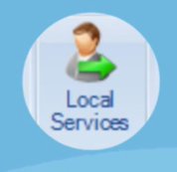
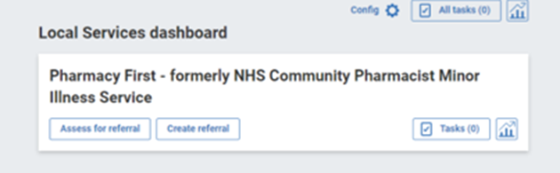
How to create a Referral using EMIS Local Services
Click the Local Services button and select ‘Pharmacy First’
From here you have two options – 'Assess for referral' or 'Create referral'
'Assess for Referral'
Click "Assess for referral" to follow the triage process which will ask some questions about the condition to ensure the patient is directed appropriately.
Note: it is possible to bypass the triage to make the referral (this stage is not compulsory)
Notes:
Integrated within the EMIS software so No log in required

Slide 2
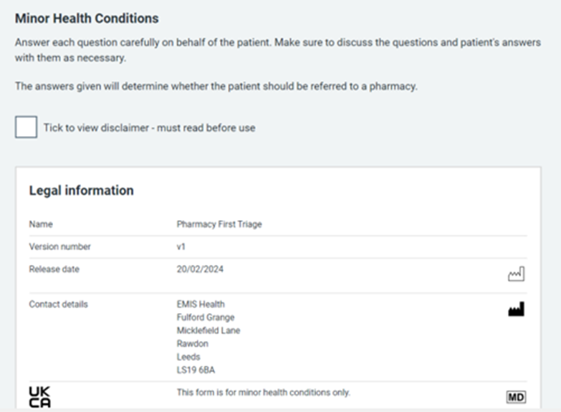
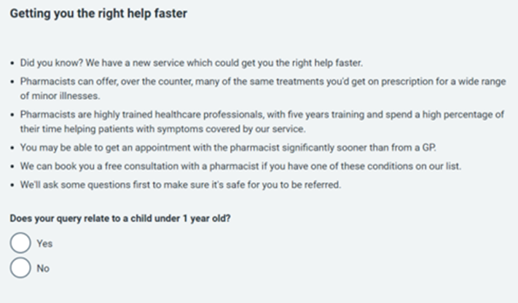
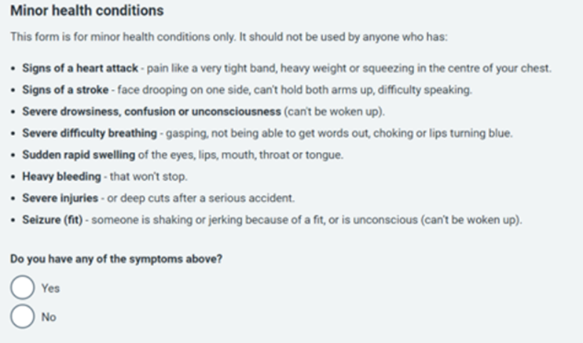
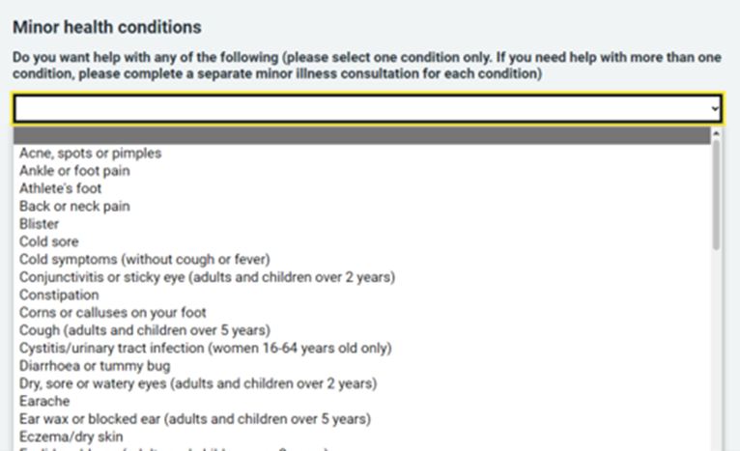
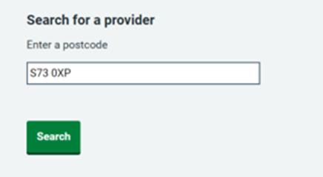
Read and accept the disclaimer
Complete the triage questions
If appropriate select 'Create Referral'
Select the reason for referral from the dropdown
A postcode search function for options of nearby pharmacies that are offering the service will be presented. The patient can choose the Pharmacy that is most convenient.

Slide 3
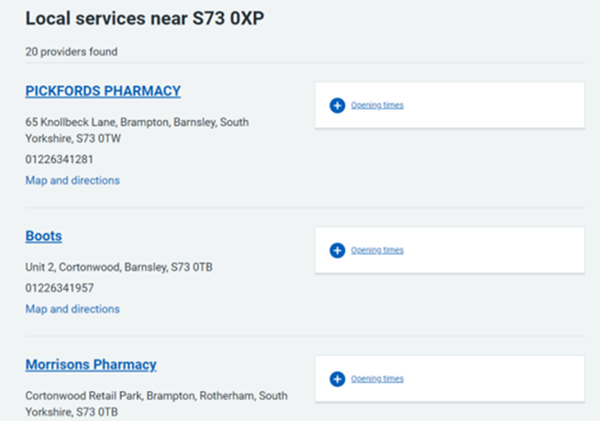
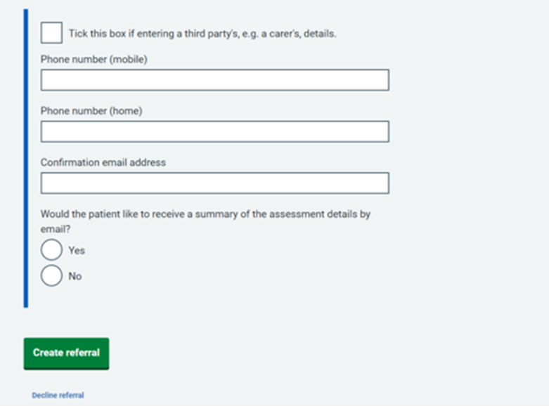
Select the Pharmacy that the patient would like the referral to be sent to.
Once the Pharmacy has been selected, check the details of the referral are correct and select 'Create Referral'

Slide 4
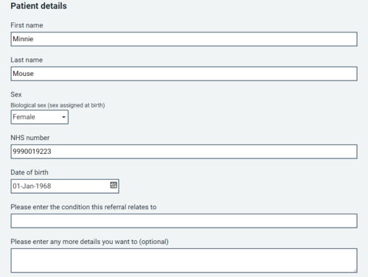
'Create Referral'
Type in the post code of the patient's choice to show a list of pharmacies in the area.
Select the pharmacy of the patient's choice.
Type in the reason for referral and select 'Create Referral'

